Slide 1
Github: a powerful resource for scientific communication
Phillip Wilmarth Proteomics Shared Resource OHSU
Notes:
I would like to thank the organizers for this opportunity to tell you about using Github to do scientific communication resource. Github is not a proteomics resource like UniProt. Github is something that you can use to create *your* own proteomics resources.

Slide 2
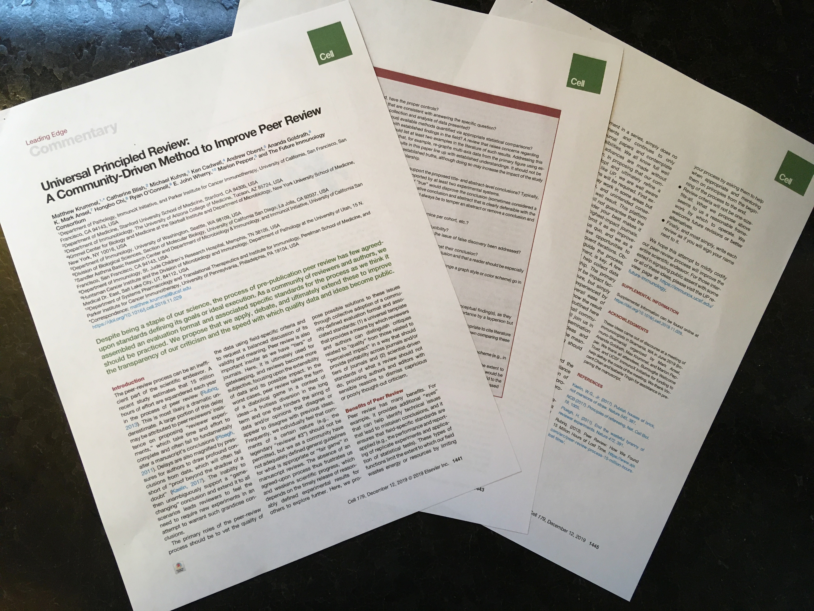
Scientific papers used to be actual paper!
Notes:
The center piece of scientific communication is the publication. They used to be printed on paper.

Slide 3
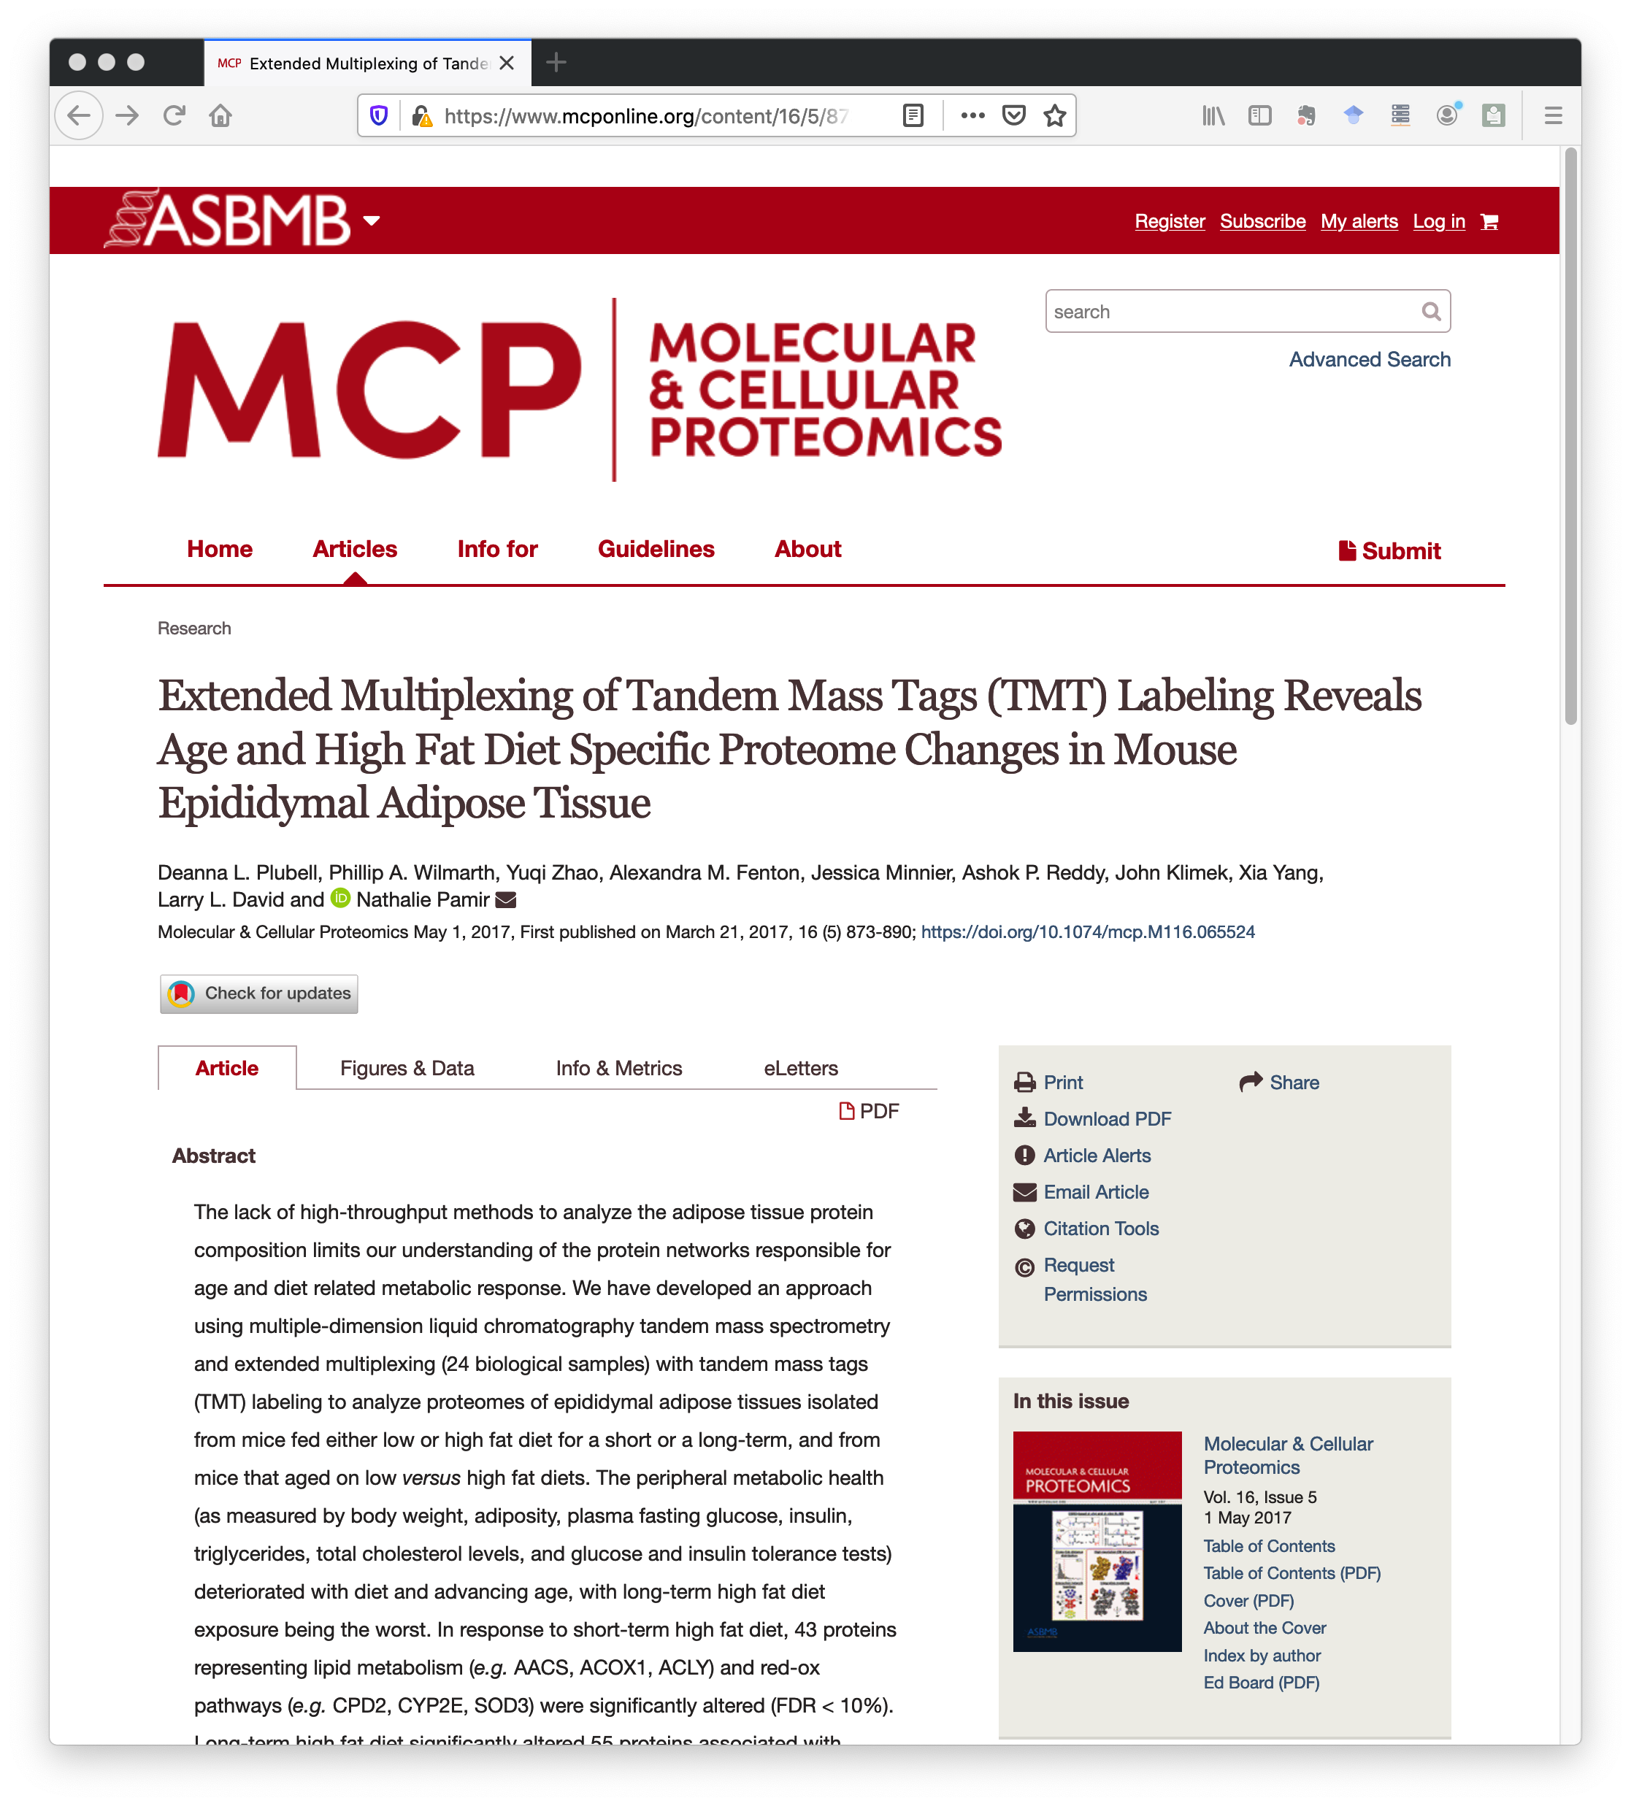
Articles are now multi-media
Notes:
Now everything is electronic – journals and papers. Here is a 2017 MCP paper where the IRS normalization method for multi-plex TMT experiments was first described. We have the article in there somewhere, but there is a lot screen real estate devoted to other things.

Slide 4
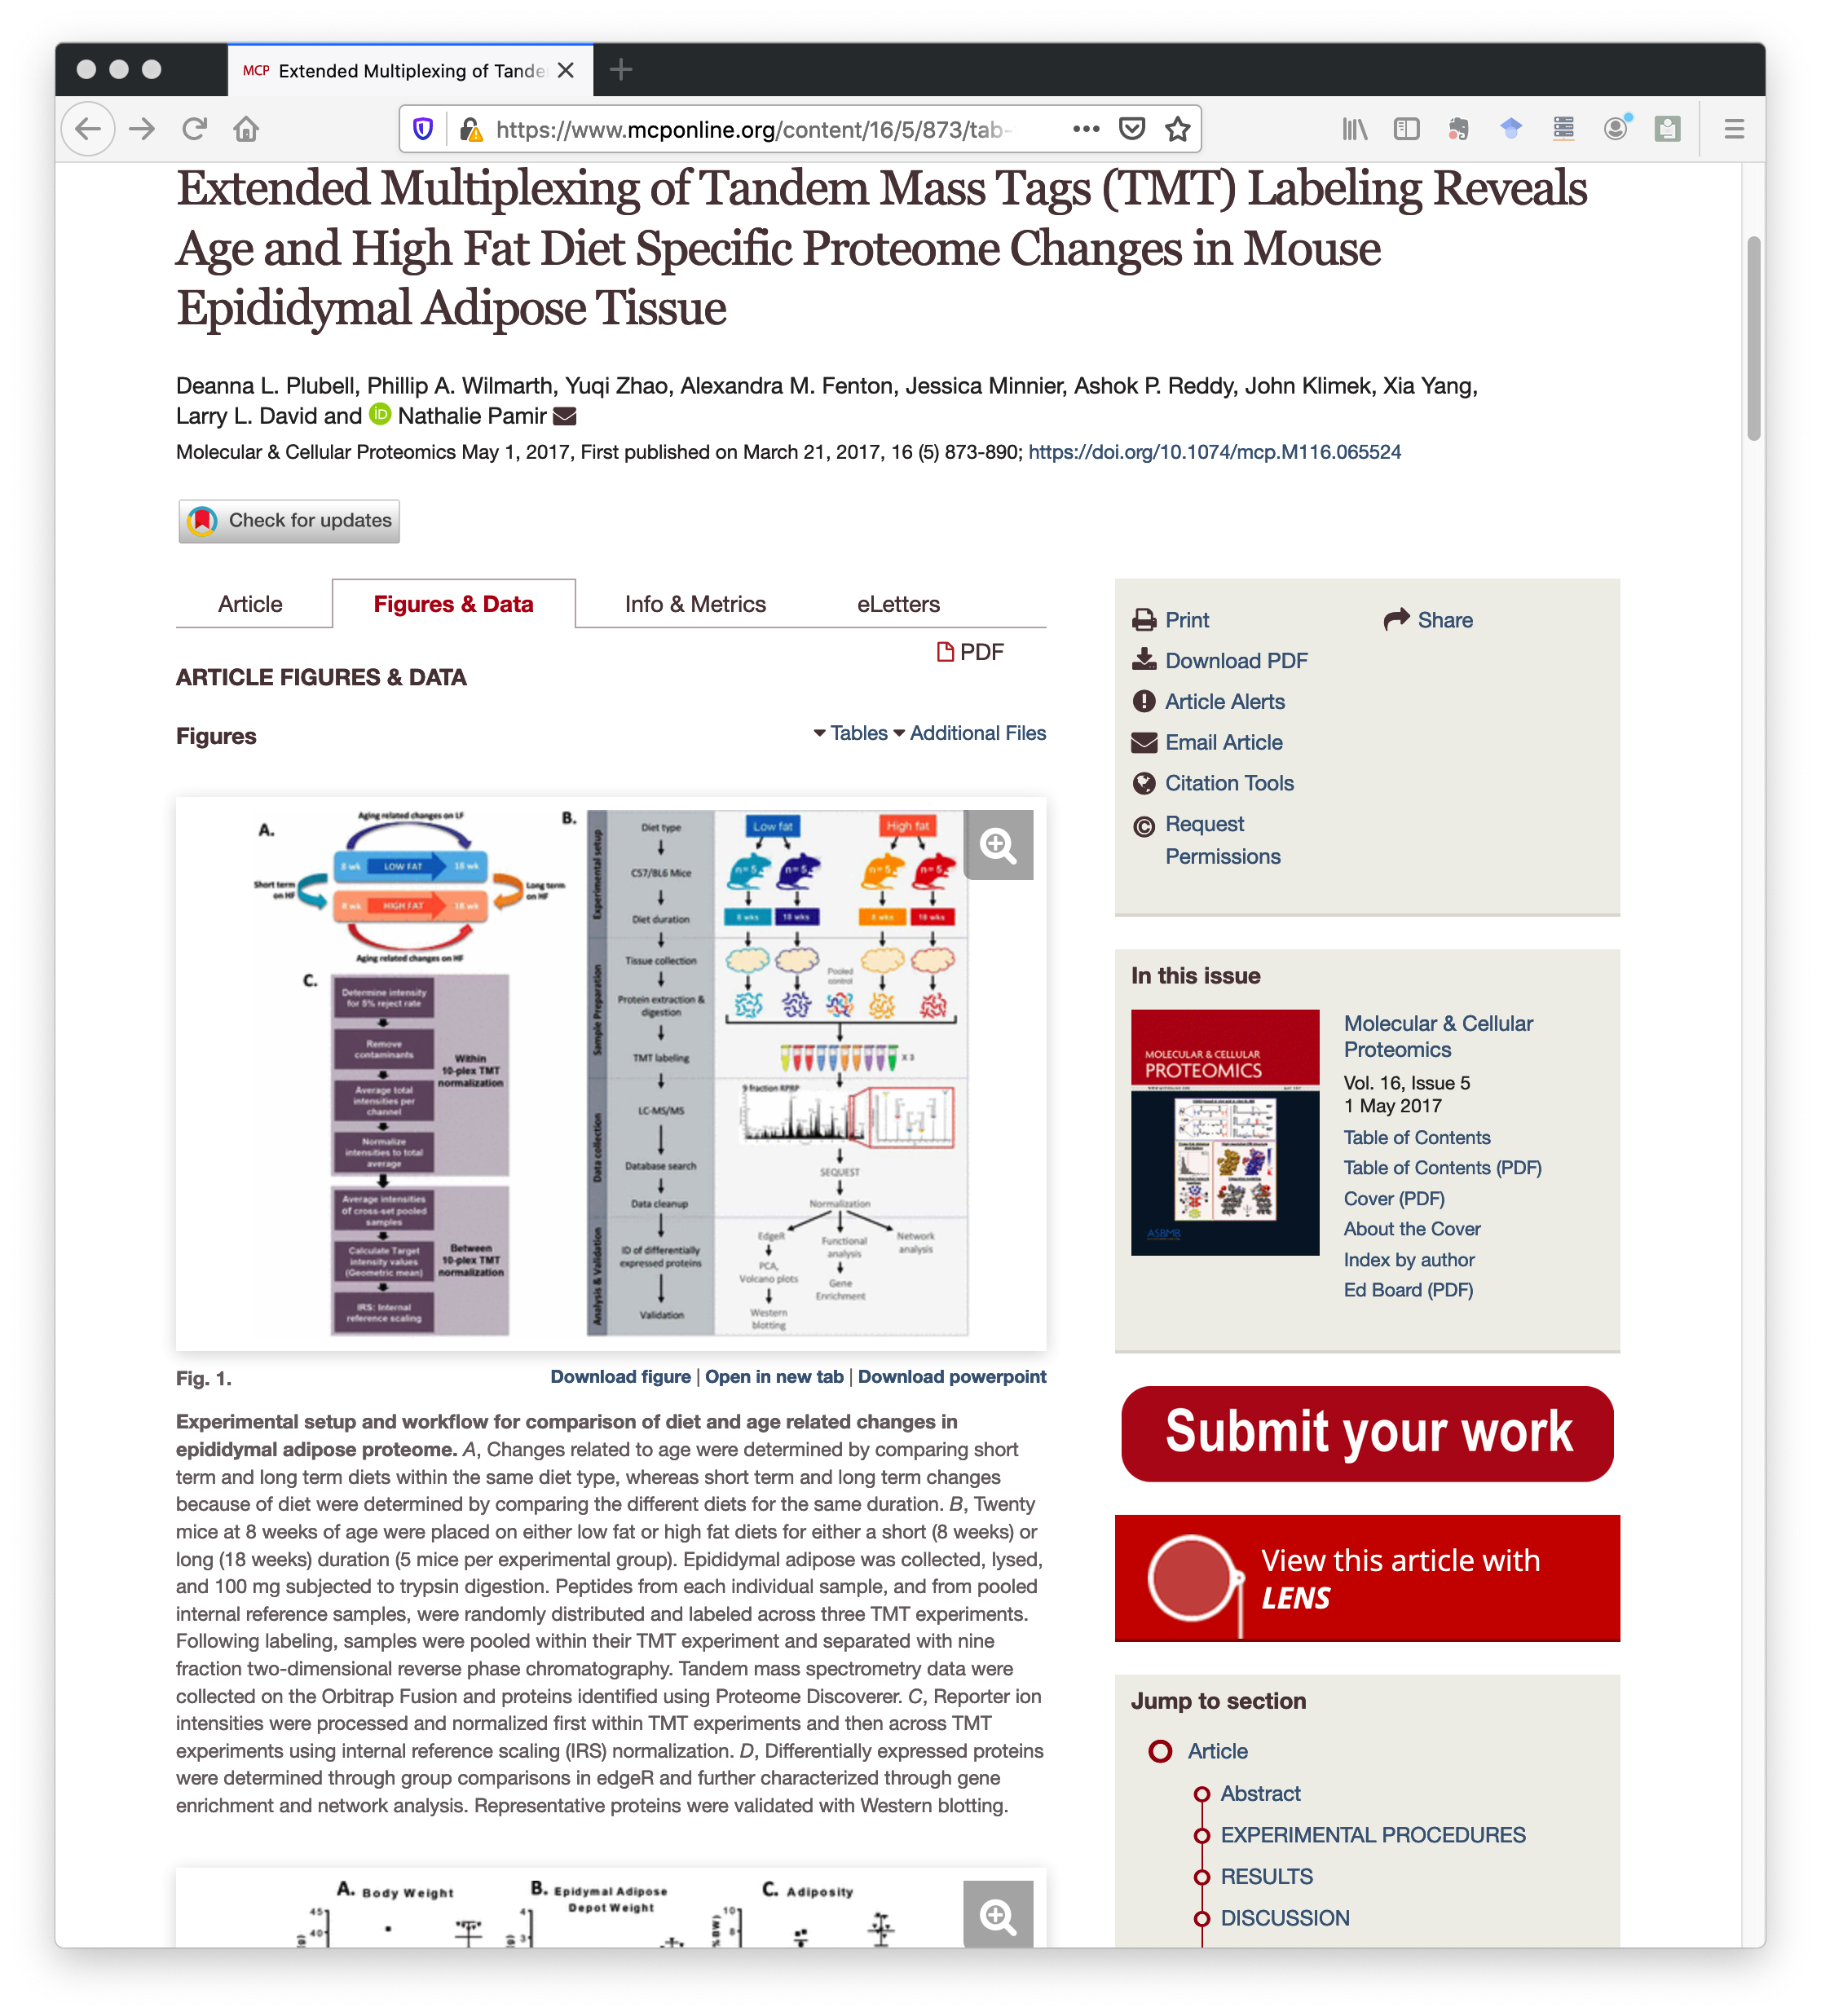
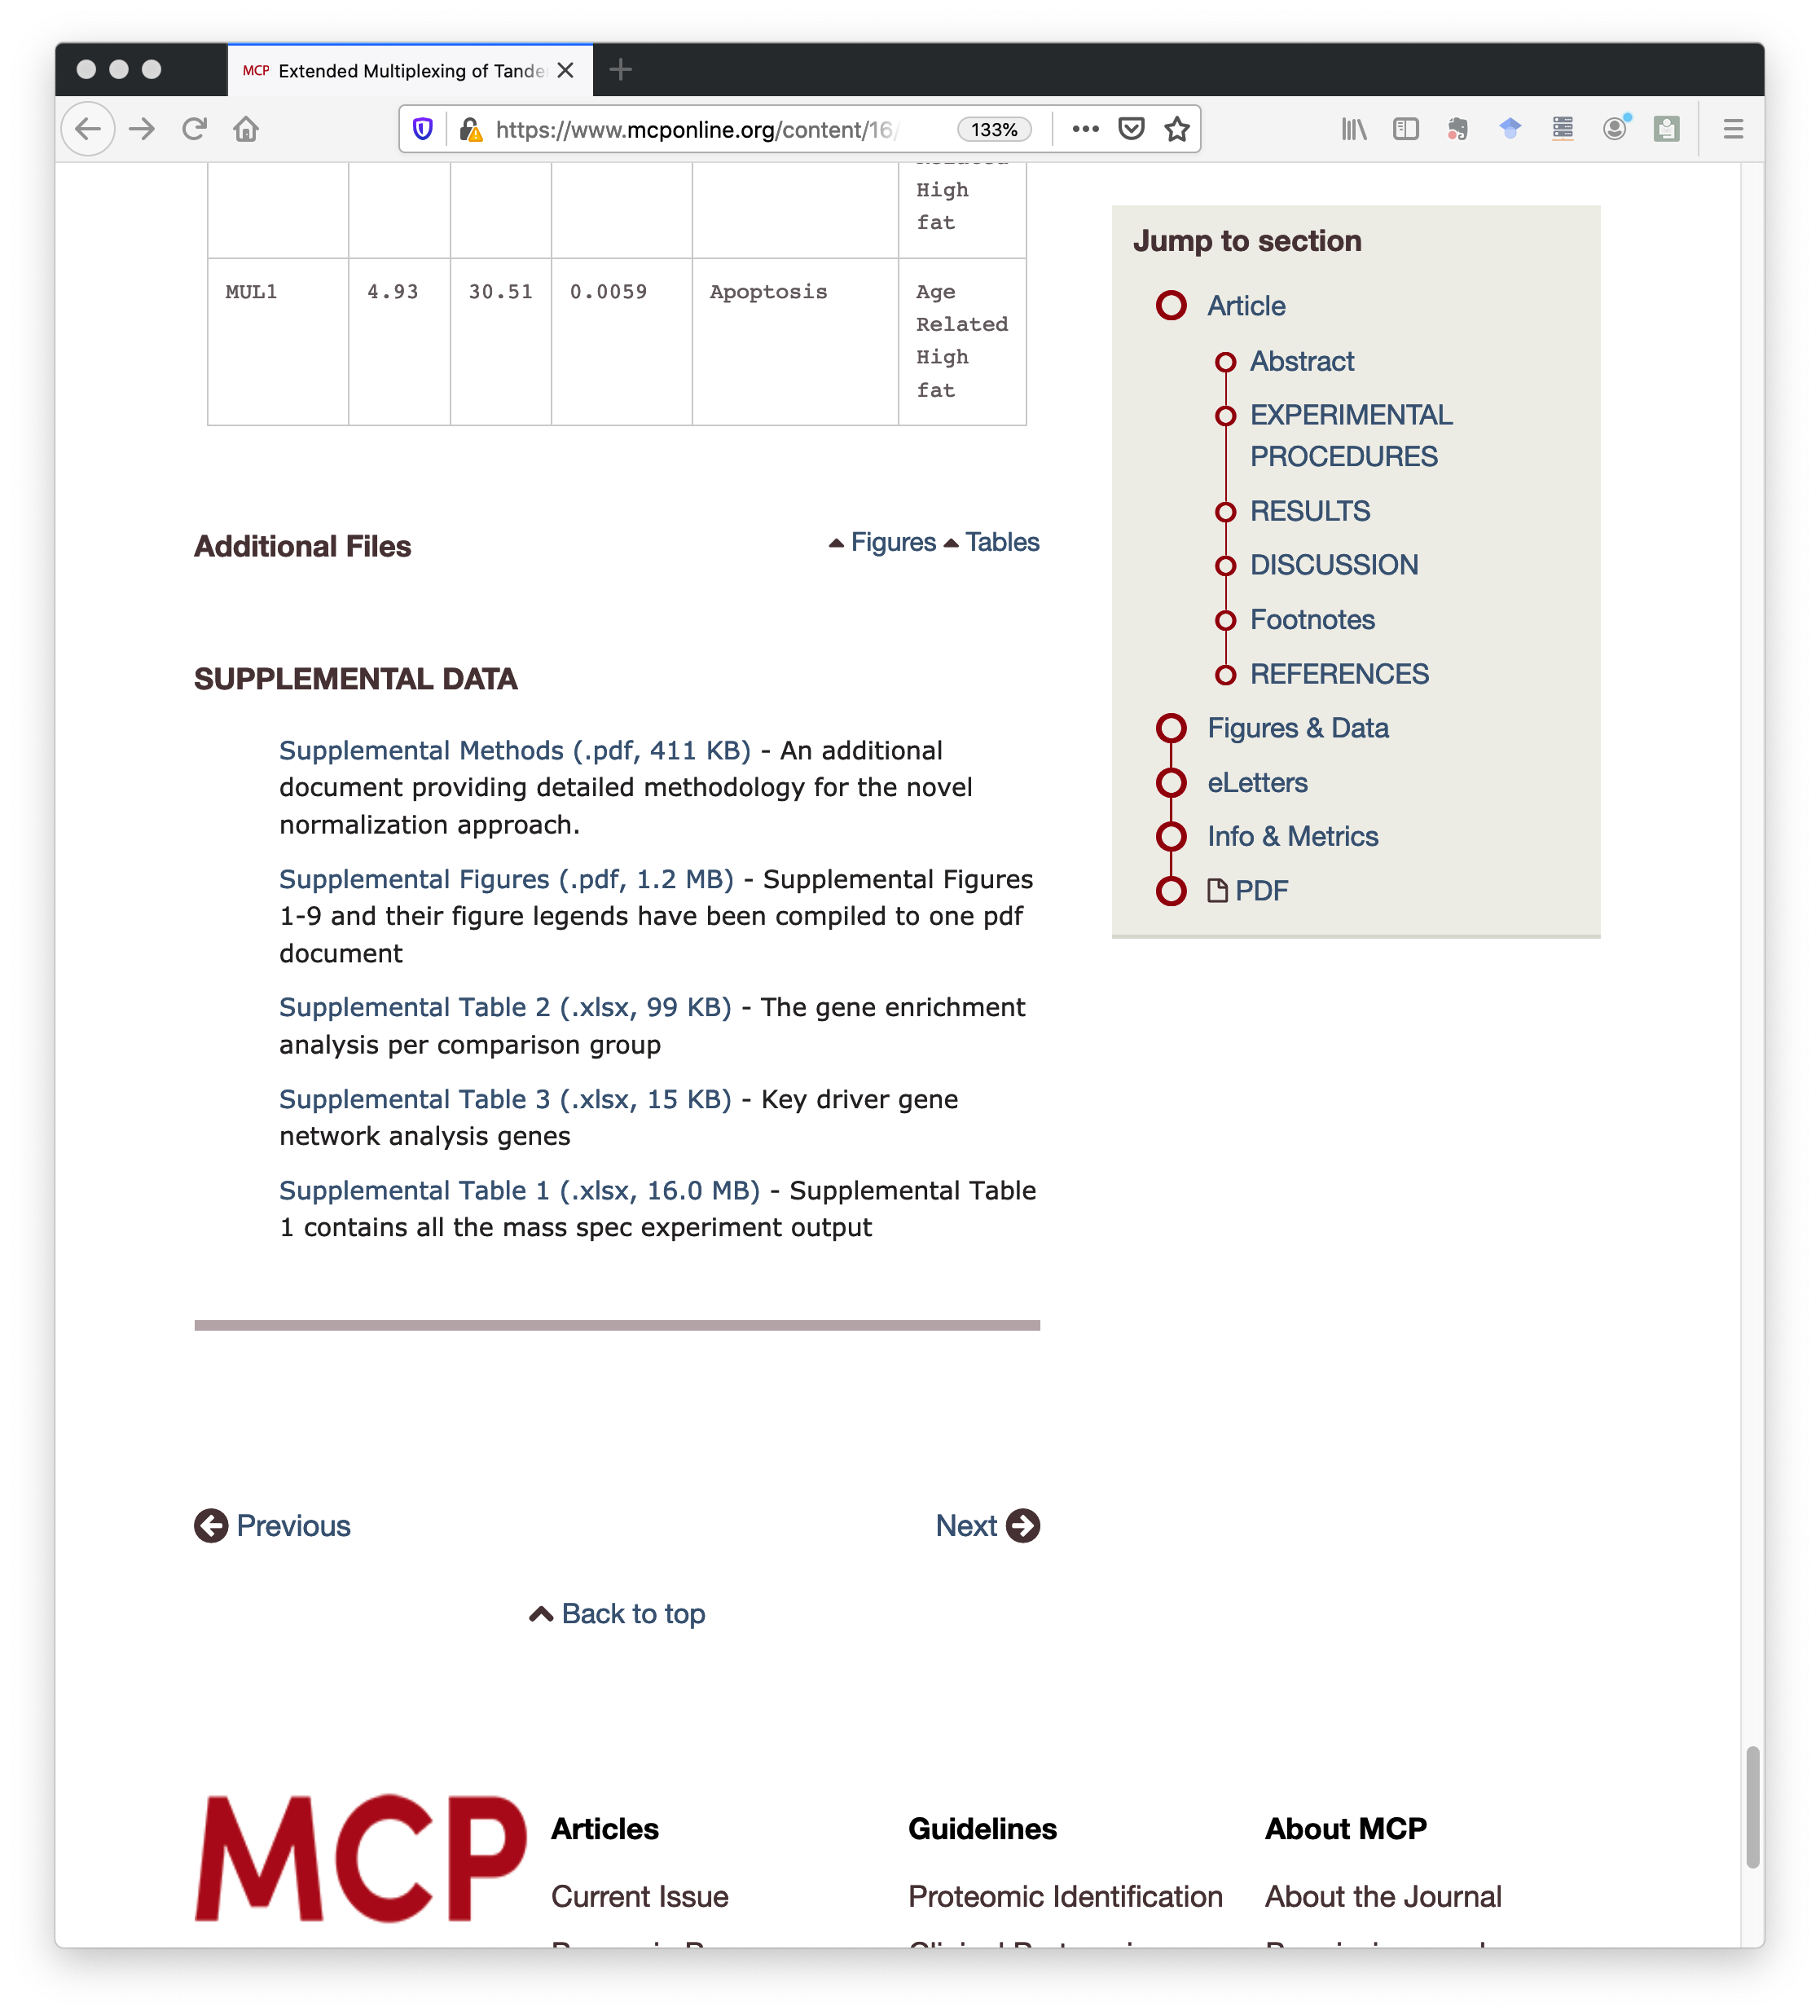
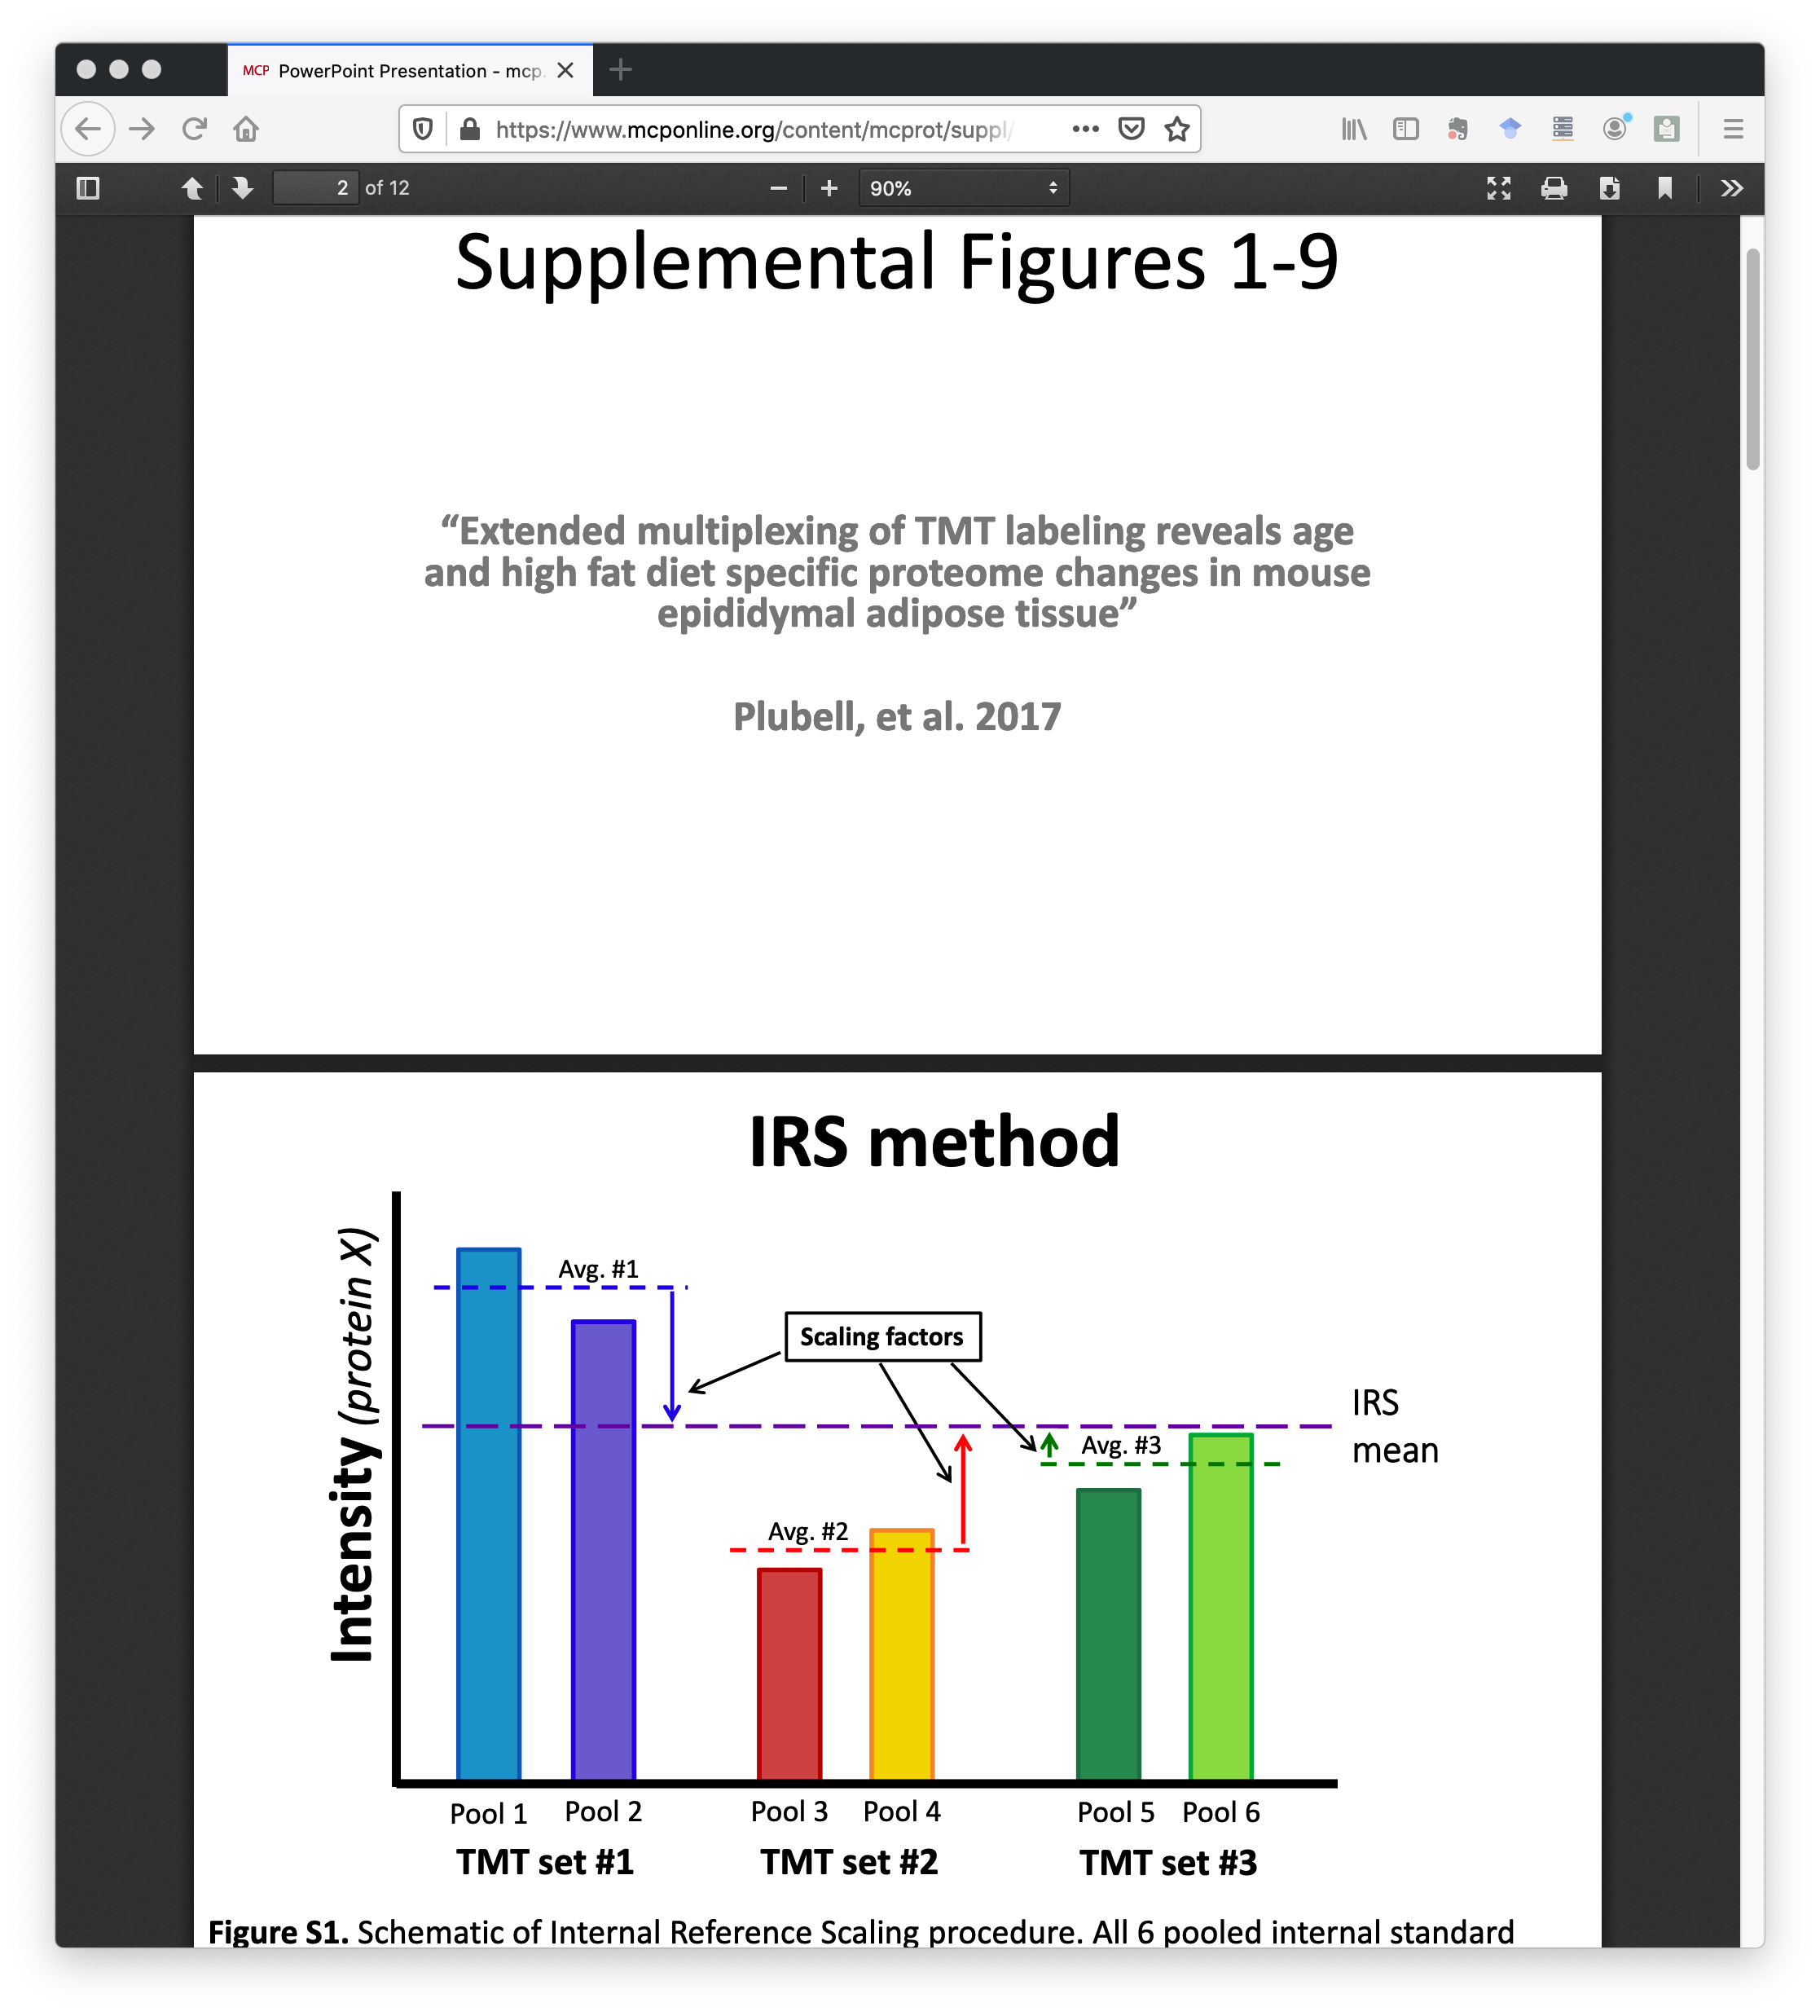
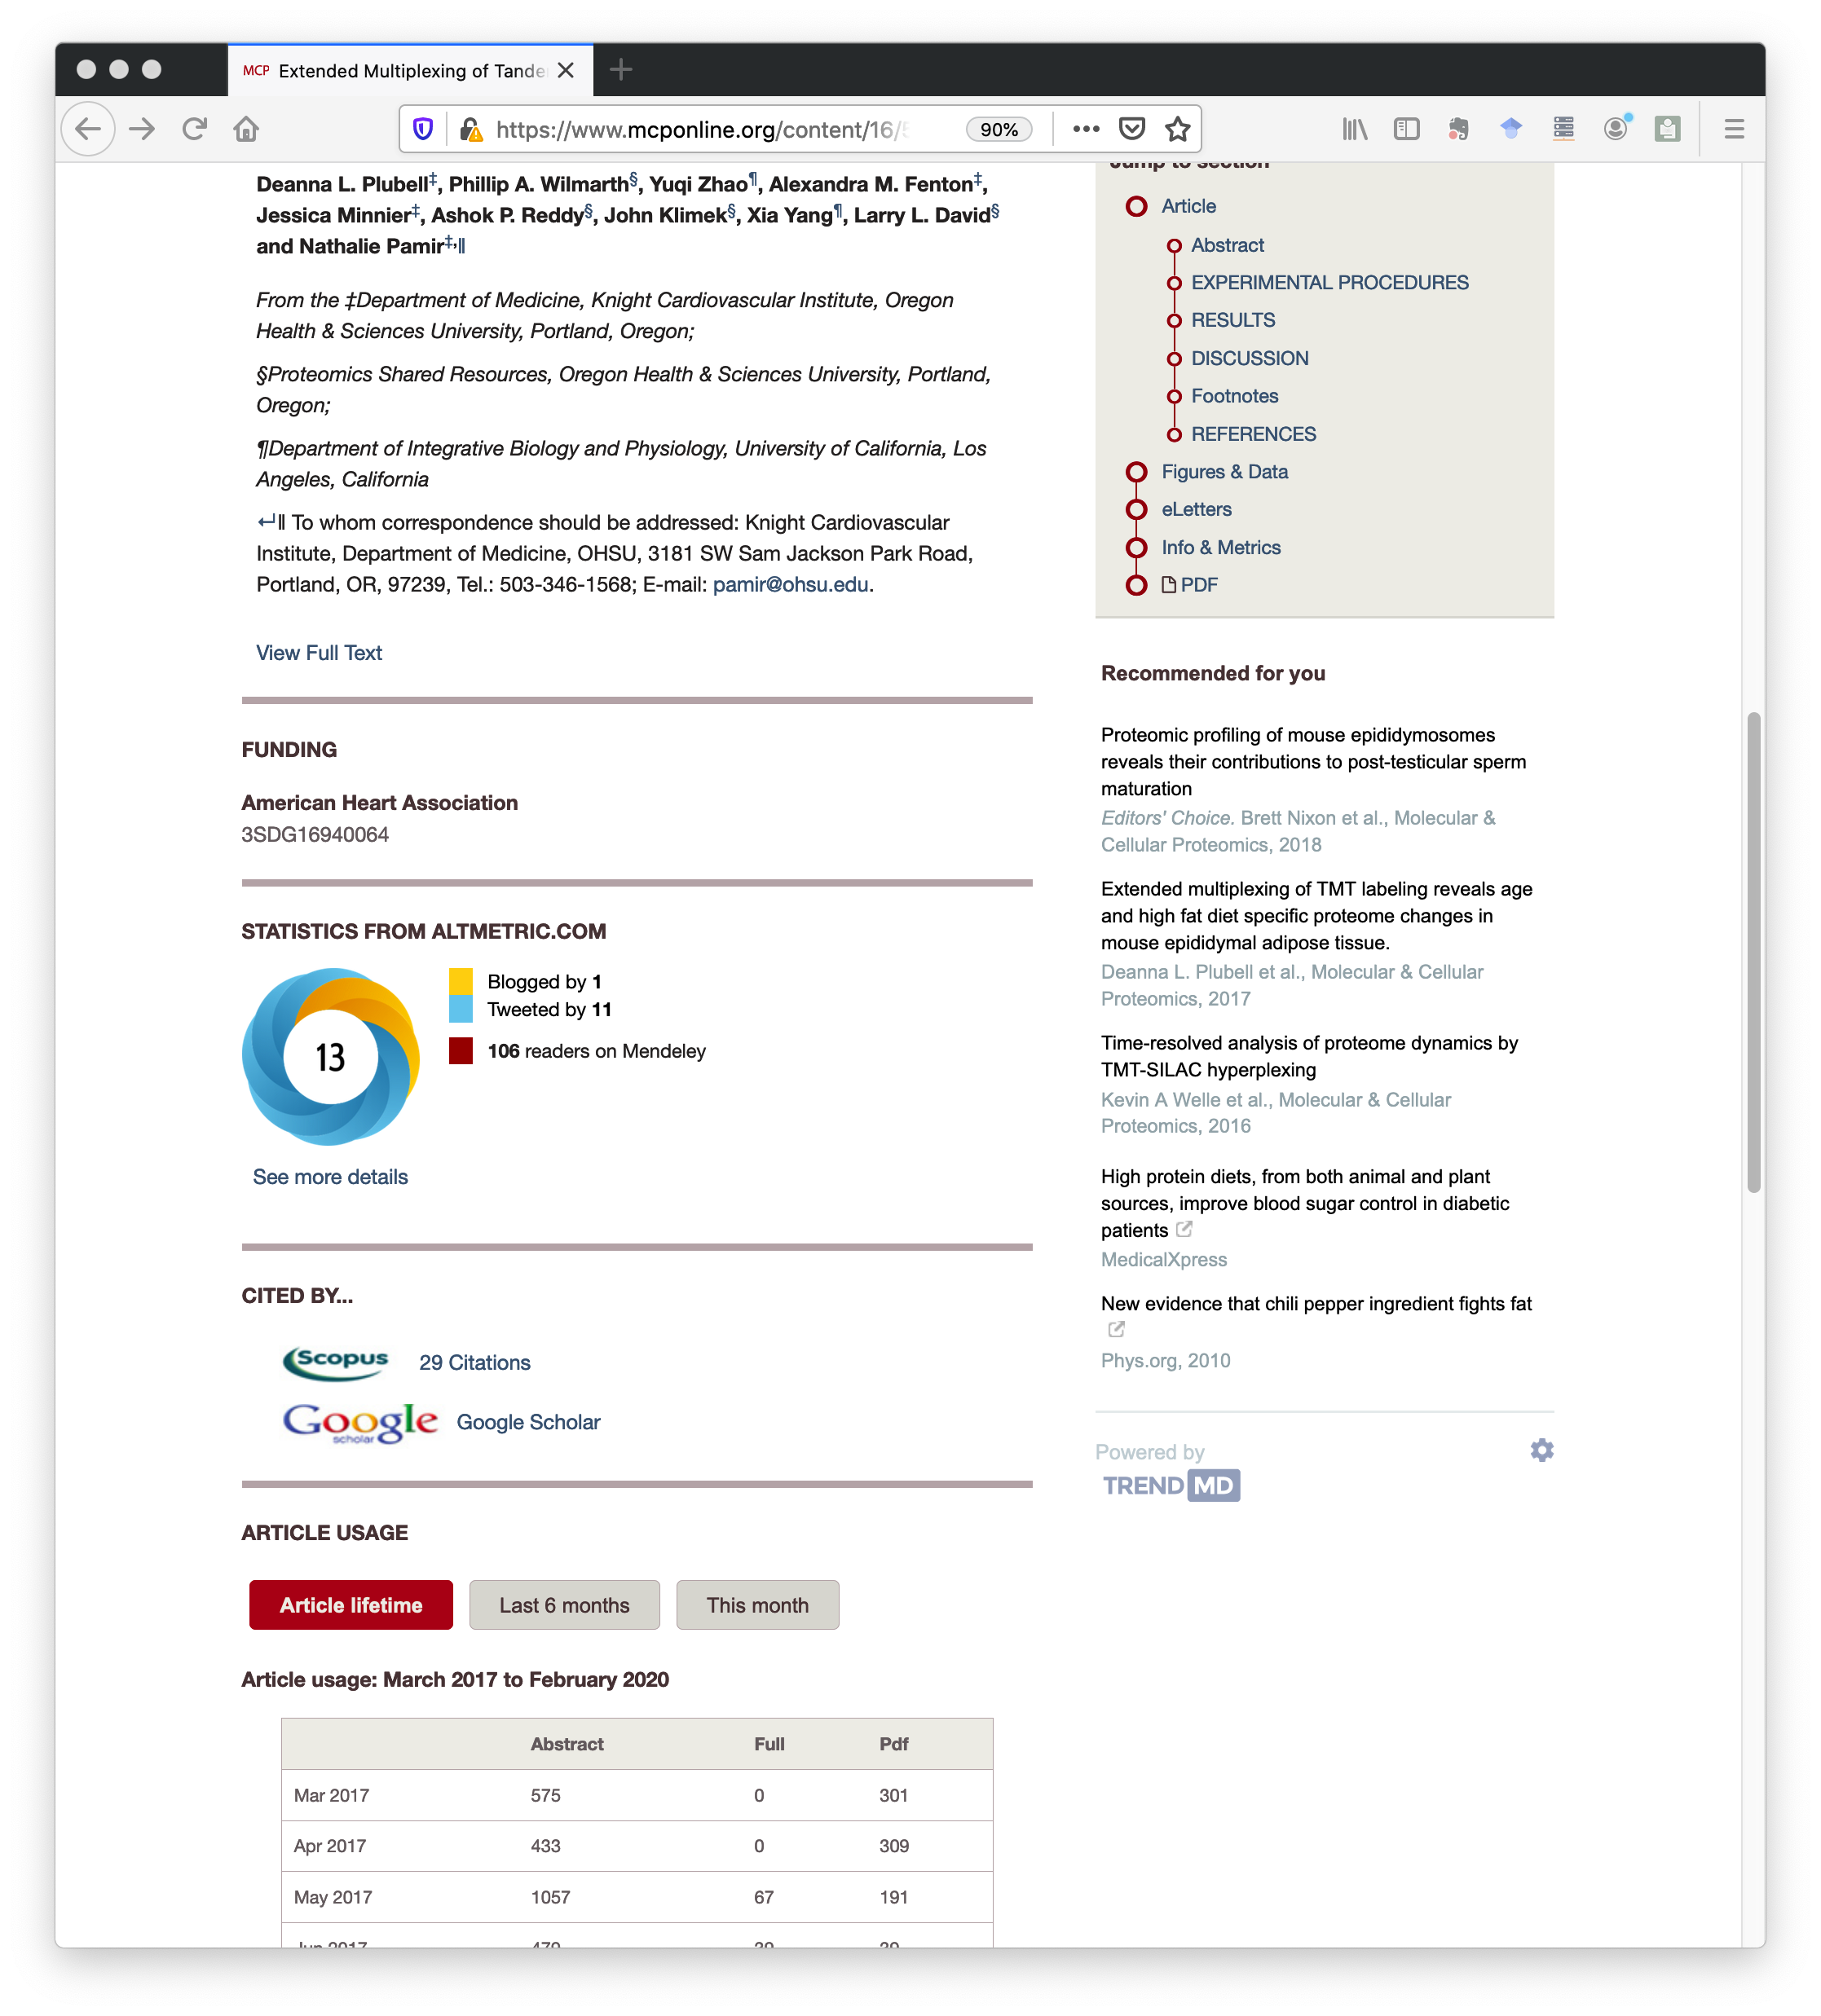
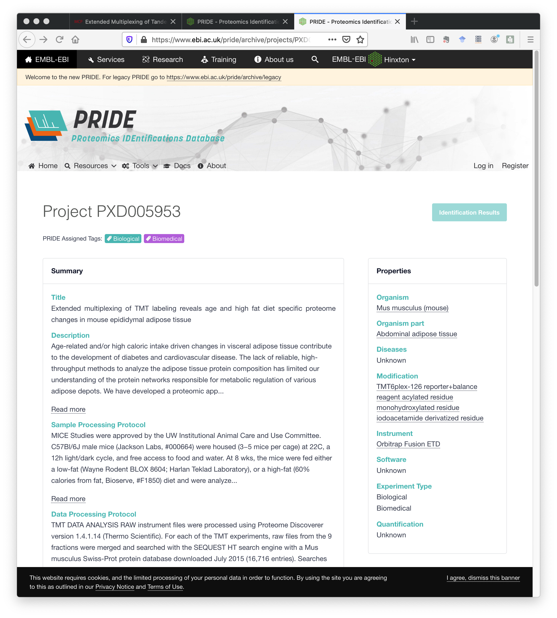
Figures
Main Article
Supporting Files
Metrics
Supplementals
Data Archives
Notes:
A scientific publication now consists of many parts. We have the main article. We can skip to the figures or tables. There are links to supplemental files. We have extra methods, figures, and data tables for this paper. There are metrics like social media activity, views, and downloads. We also have associated data in archives and repositories. Is there a better way to integrate all this information?

Slide 5
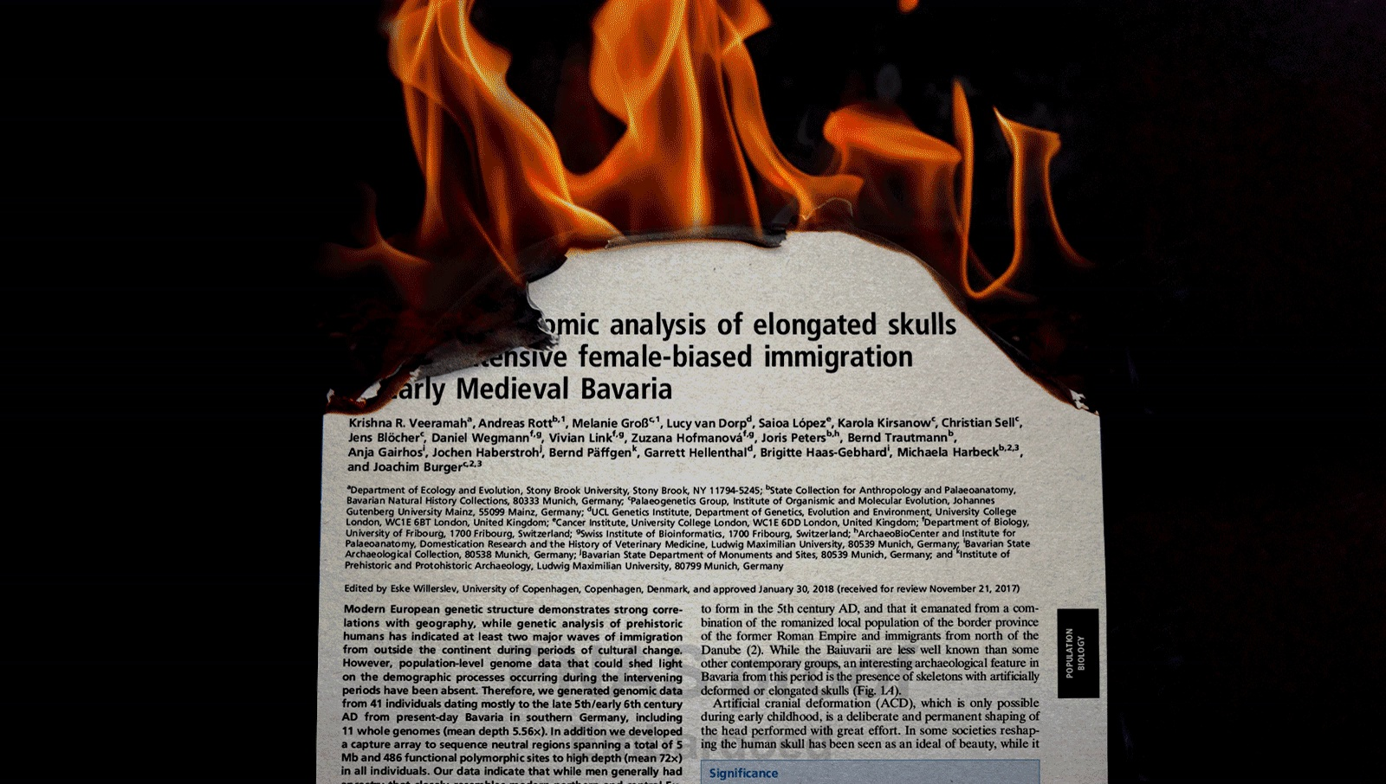
Are scientific papers the best way to communicate science?
Somers J. “The scientific paper is obsolete.” The Atlantic. 2018 Apr 5.
Notes:
This Atlantic article from a couple of years ago claims that the scientific paper is obsolete. The article was about “notebooks” could replace scientific papers.

Slide 6
What are notebooks? Can they replace papers?
Notebooks are web server applications controlled with web browsers
Notebooks are stories with formatted text, code cells that run, and output from the code cells (graphics)
Notebooks are made with Jupyter or R Markdown (RStudio) + knitr
Notes:
The Atlantic article was about Mathematica notebooks and open source Jupyter notebooks. These notebooks are web server applications with some connection to a local programming environment. You create and interact with notebooks through web browsers. You can think of notebooks as data analysis stories told through a linear series of cells. These cells can rich text formatting (like a web page), executable code cells (typically Python or R), and the output (graphics and text) from the code cells. I mostly use Jupyter notebooks, but R Markdown is similar. Notebooks are perfect for data analysis stories.

Slide 7
Notebooks can augment (not replace) papers
Notebooks particularly good for computational steps
Computational steps only part of a paper’s story
Notebooks, version control, and Github go together
Notes:
I think that life science research is too complex to replace with notebooks. However, the computational steps in research projects are hard to describe with just text. Notebooks are much better ways to describe these steps. Computational steps are only part of the story for most life science research, so notebooks can augment instead of replace papers. Adding notebooks to the supplemental files makes sense. It turns out that notebooks, version control, and Github all go together.

Slide 8
What is Github?
Software hosting service using Git version control
40 million users and over 100 million repositories
Over 6.4 million Jupyter notebooks
Github is more than source code
Collaborative work on projects
File syncing and backup
Simple web content creation and hosting
Notes:
Alright, we are finally talking about Github! It is the world’s largest software hosting service and uses Git distributed version control. Github has grown rapidly and is enormous. Github has strong support for Jupyter notebooks and hosts about 6.4 million notebooks currently. Github has a lot of additional functionality: it facilitates collaborative work on software (and other) projects, it acts like a syncing service to protect your files, and it supports web content creation and hosting.

Slide 9

Github
Git
Repository
Push
Push
Pull
Pull
Pull
Git Repository
Git Repository
Git Repository
Commit
Commit
Commit
Update
Update
Update
Working Copy
Working Copy
Working Copy
Work PC
Home PC
Other Users
Notes:
When you are trying to learn about Git and Github, it helpful to have a mental picture of how the pieces connect. Github itself is a collection of repositories that reside in the cloud. Copies of those repositories are mirrored on your local computers. That is the distributed part. For example, I go to OHSU and work on some code. I work on a local copy of the files in a Git repository. I save my work by committing the changes. I can push those changes to the corresponding Github repo, cycle home, pull the updated code to my home PC, and continue my work. Lather, rise, and repeat. Other users may just be fetching code from the repo to run on their PCs.

Slide 10
Why learn Git and Github?
Journals and data archives are not under your control
Scientific research often behind paywalls – limits access
Communication is more than just scientific papers
Protocols and methods, meeting presentations, education
Computer scripts – utilities and analyses
Github site is a data science resume
Notes:
Git and Github are complicated topics that take some serious time and effort to learn. There are good reasons to make the time investment. Journal articles and data archives are not under your control and will get out of date. The content may also be behind paywalls and limit access. What if you had a protocol described in a previously published paper that has changed? How does the community find the updated protocol? The scientific paper is only part of the professional communication we need to do. The version control and sharing features of Github are great for lab protocols, tutorials, and meeting presentations. If you write scripts to do routine tasks, you can share them with the proteomics community. Data analysis skills are valuable, and the content you have at Github is a way to showcase your skills.

Slide 11
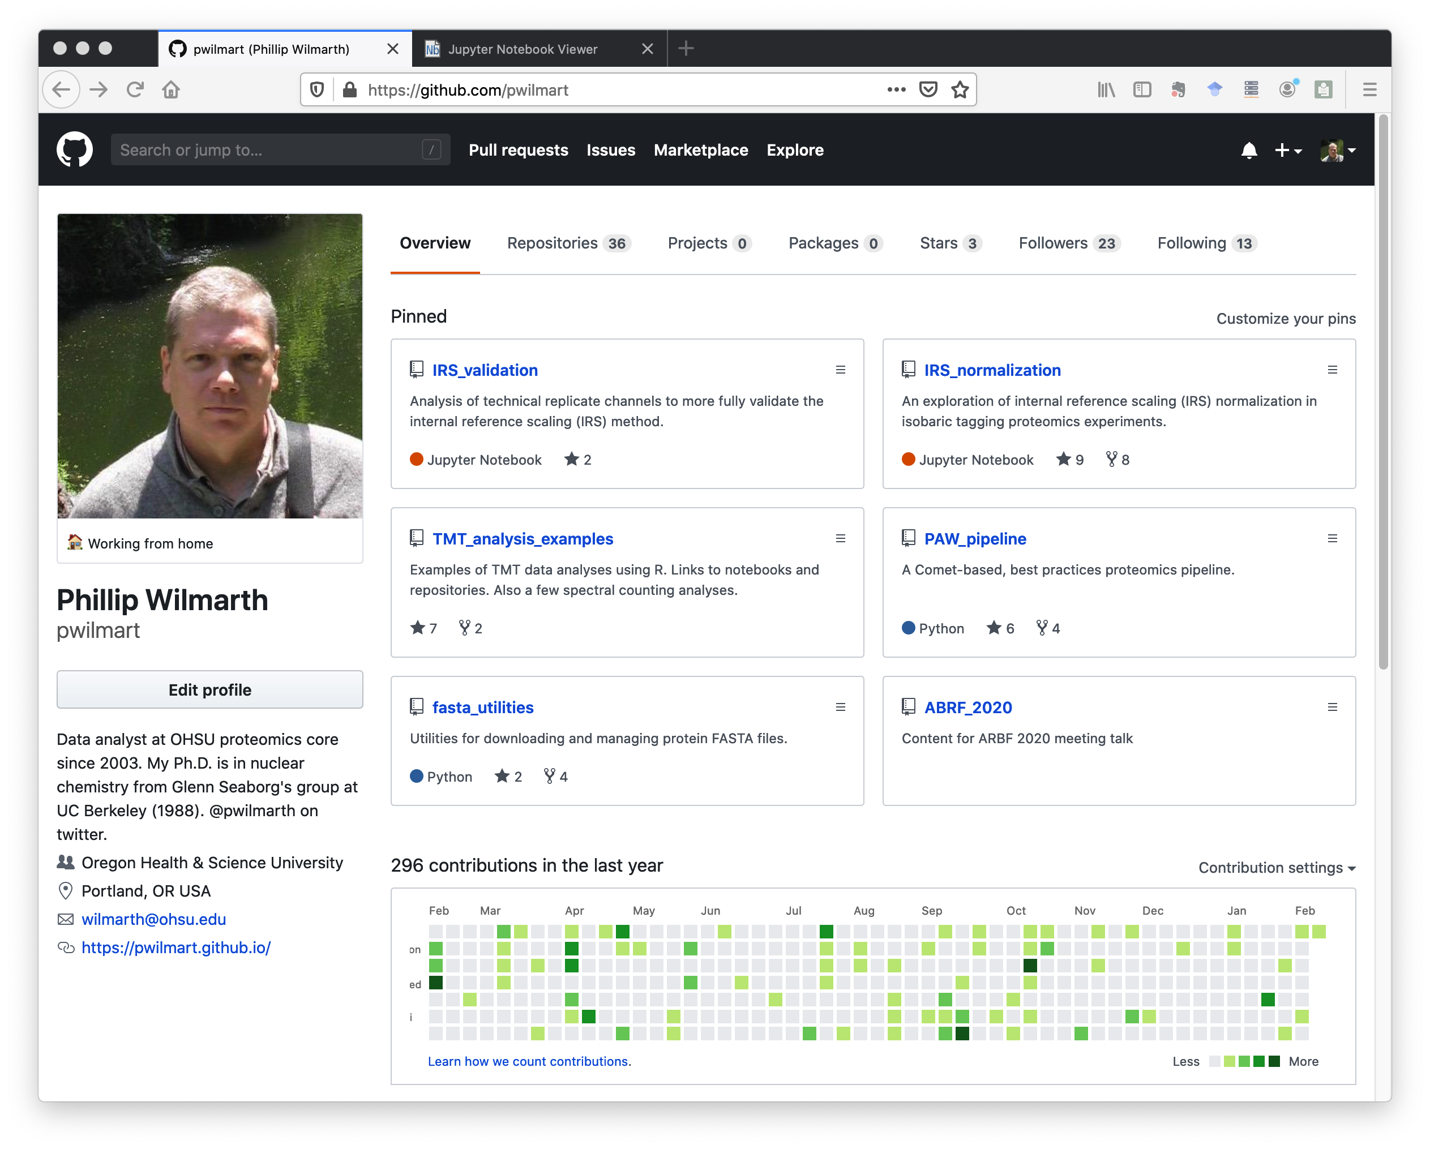
www.github.com/pwilmart
Profile
information
Pinned
repositories
Website URL
Notes:
This is my Github site. There is profile information on the left. You can pin up to 6 repositories to the landing page. I have a couple of repos about IRS data normalization, one for tandem mass tag data analysis examples, my proteomics pipeline software, some utilities for managing FASTA protein databases, and even this talk. Each Github account can also have a dedicated website.

Slide 12
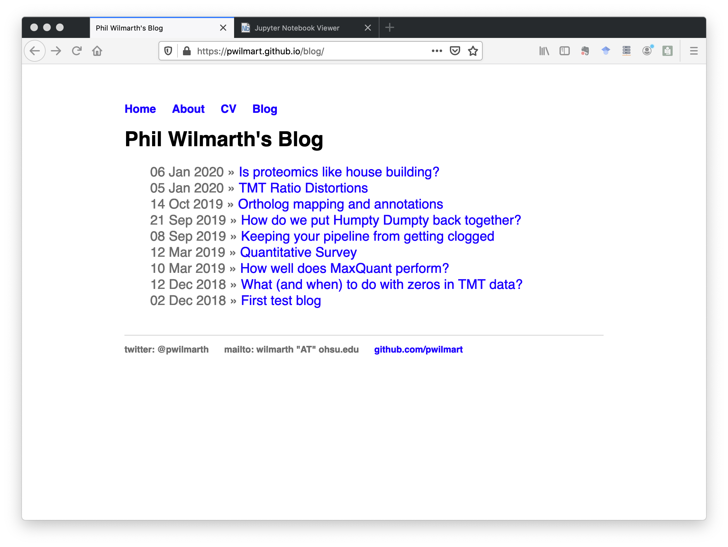
Flexible web hosting is part of Github
User can have a primary website
Each repo can have its own website
Repo README.md files rendered like websites
Notes:
Flexible web hosting and content creation is one of the best features of Github. I mostly use my main Github website for some blogging on proteomics topics. Each individual repository can also have an associated web page. The repo web pages often used for documentation, vignettes, and tutorials. Each repository can also have a README file, written in Github markdown, that gets automatically rendered as web content.

Slide 13
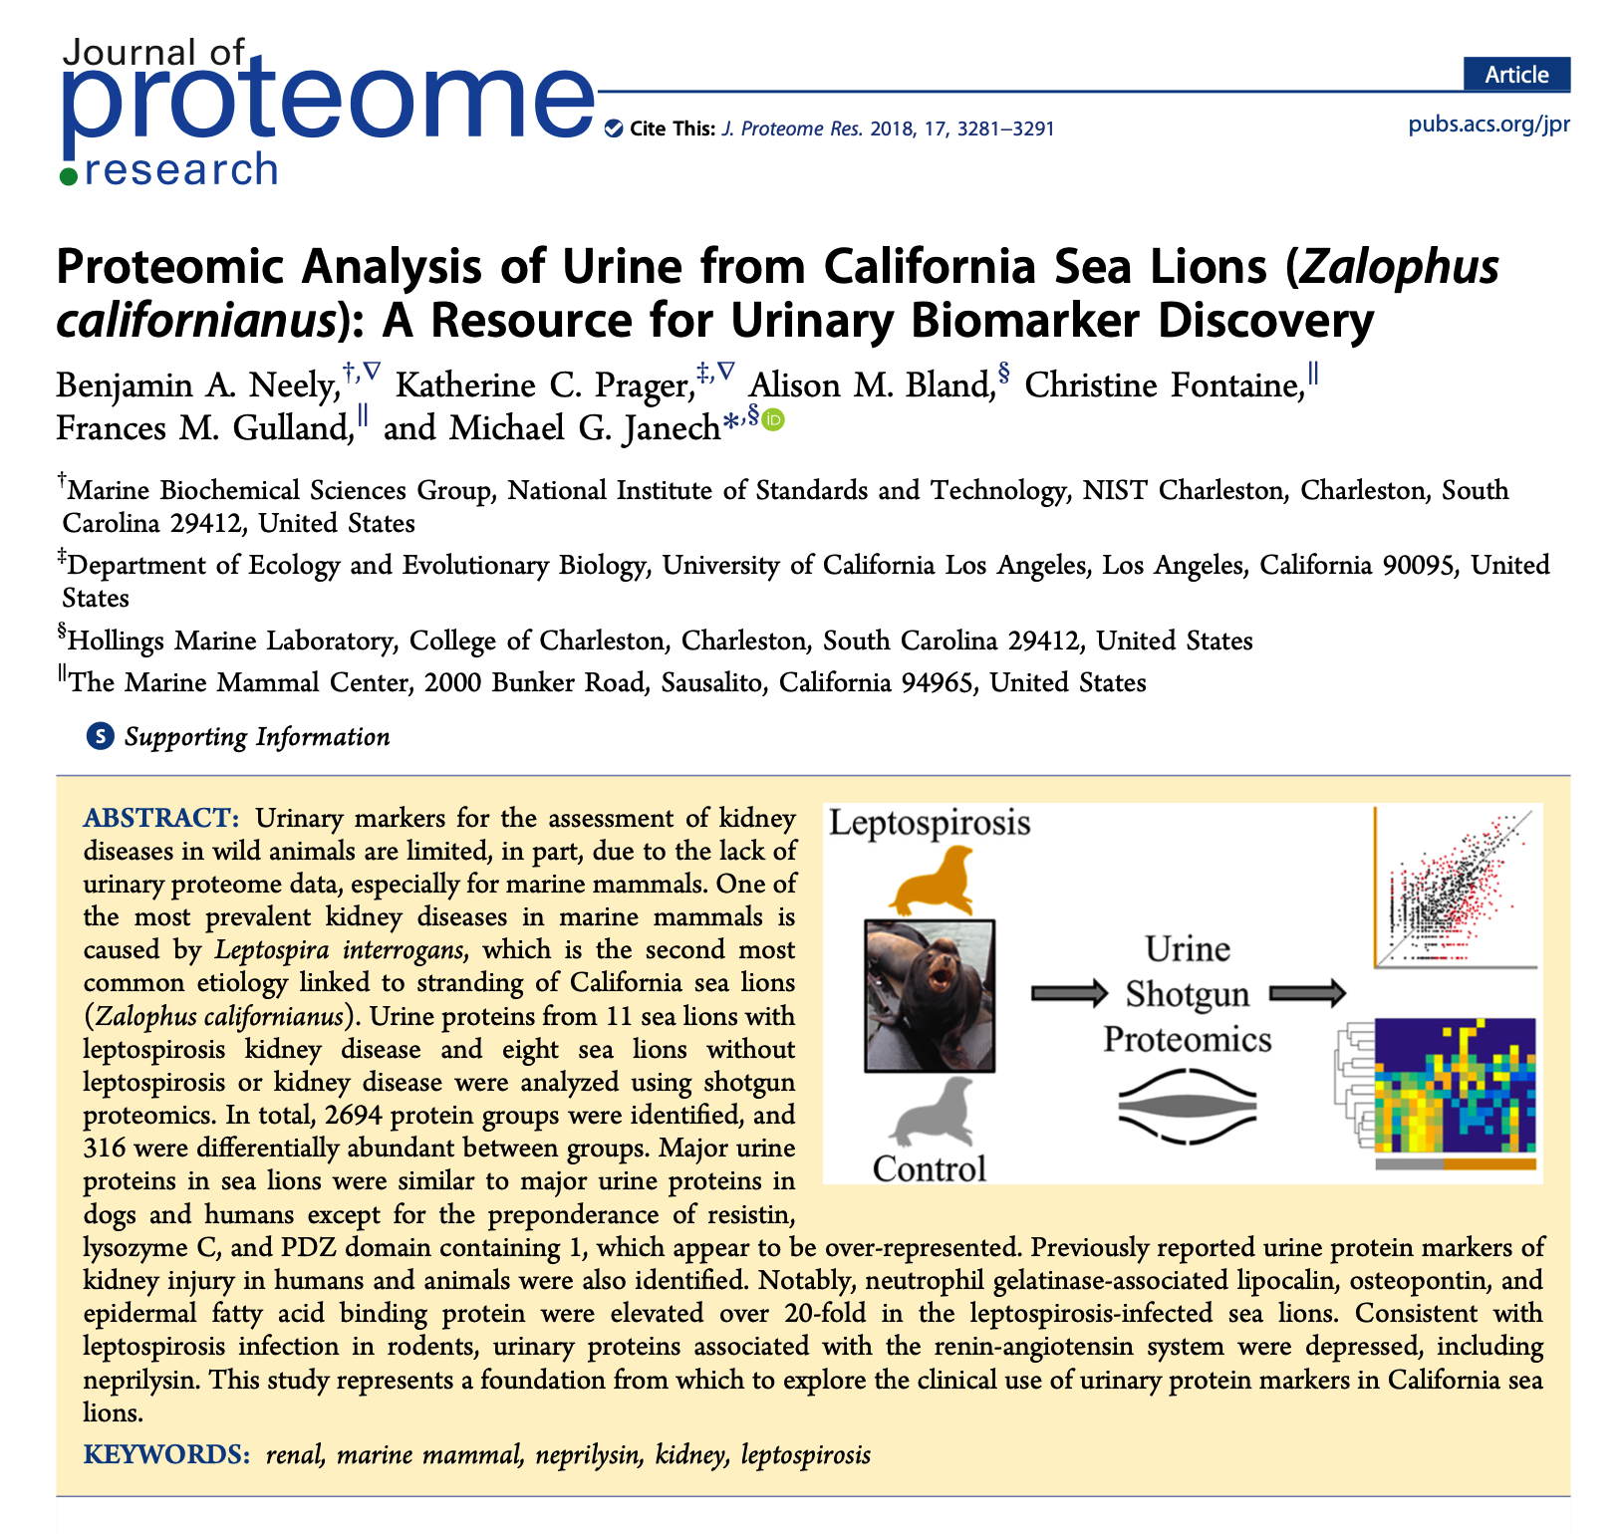
Demonstrate analysis methods and tools on publicly available datasets
Sea lion urine study [Neely, et al., JPR 2018 (17) 3281-91]
Publication was before sea lion genome was sequenced
Would a sea lion protein database improve the results?
Redo analysis with PAW/Comet wide tolerance semi-tryptic searches and sea lion protein database
Notes:
One of the things you can do at Github is demonstrate data analysis topics using publicly available data. Real world examples are a more powerful way to reach your audience. I have an interest in how to analyze data from less common organisms. I heard a presentation from Ben Neely about proteomics on marine mammals at last year’s ASMS meeting. Their group published a paper about California sea lion urine samples to probe kidney disease. When that paper was published, a sea lion genome was not available. They used a combined seal and walrus protein database. The sea lion genome has since been sequenced and I was curious how the results would change if a sea lion protein database was used. I repeated the analysis with the sea lion database and my open source pipeline that uses MSConvert for RAW file access and Comet for database searching.

Slide 14
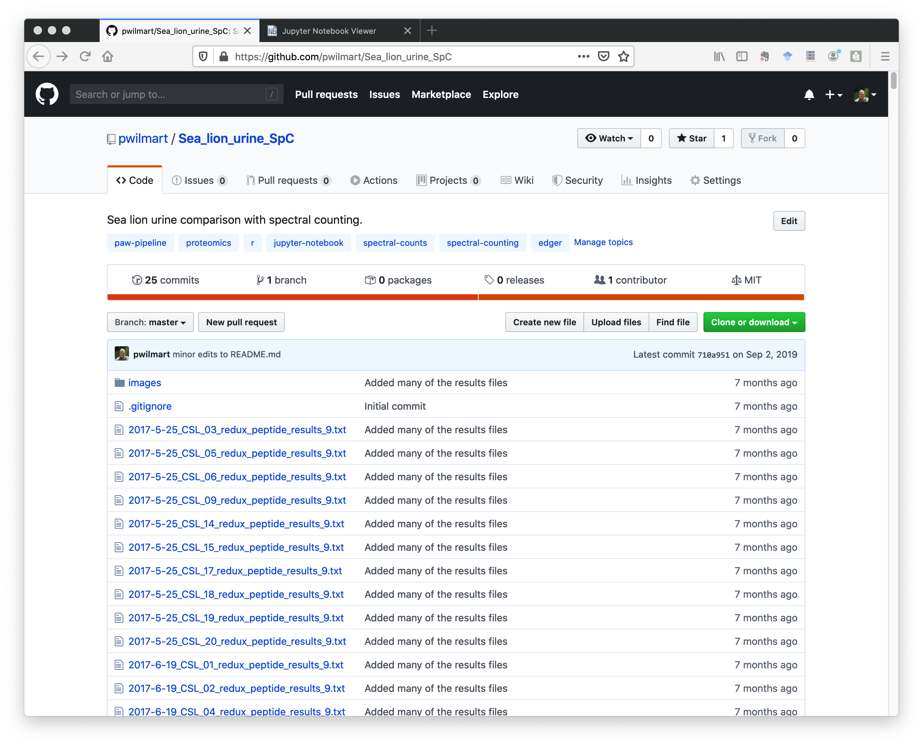
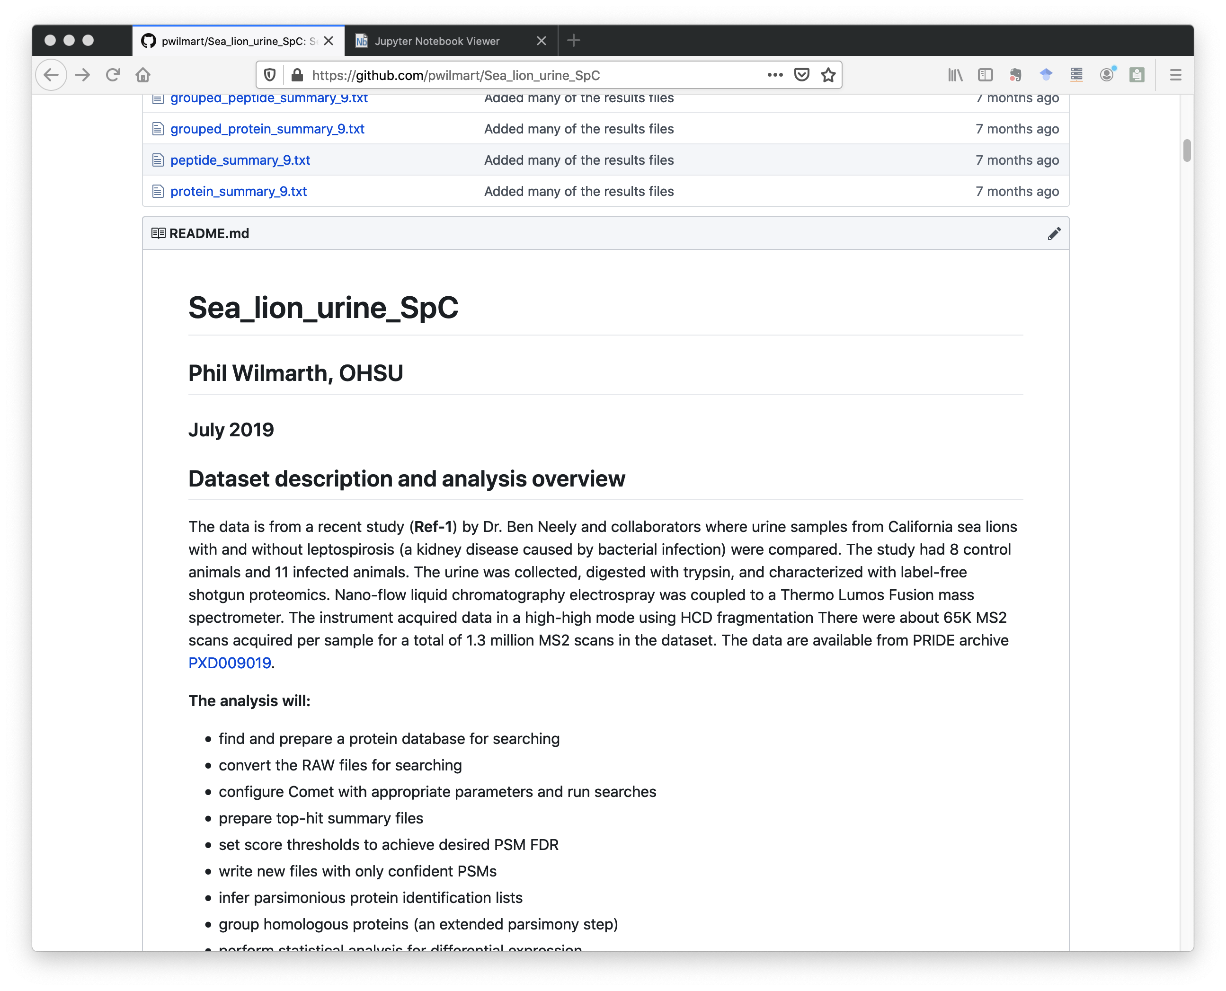
github.com/pwilmart/Sea_lion_urine_SpC
Repos start with navigations, tags, and files
README displayed after files
Notes:
This is the repository for the re-analysis. The URL is at the top. On the left, we have the start of the repository with a description, some tags, and the list of files. Github is designed to be a code repository, so we see the files first with some versioning information. If we scroll to the bottom of the files (on the right), we see the README markdown file displayed as rich web content. We have headers, text, a hyperlink to the data archive, and a list.

Slide 15
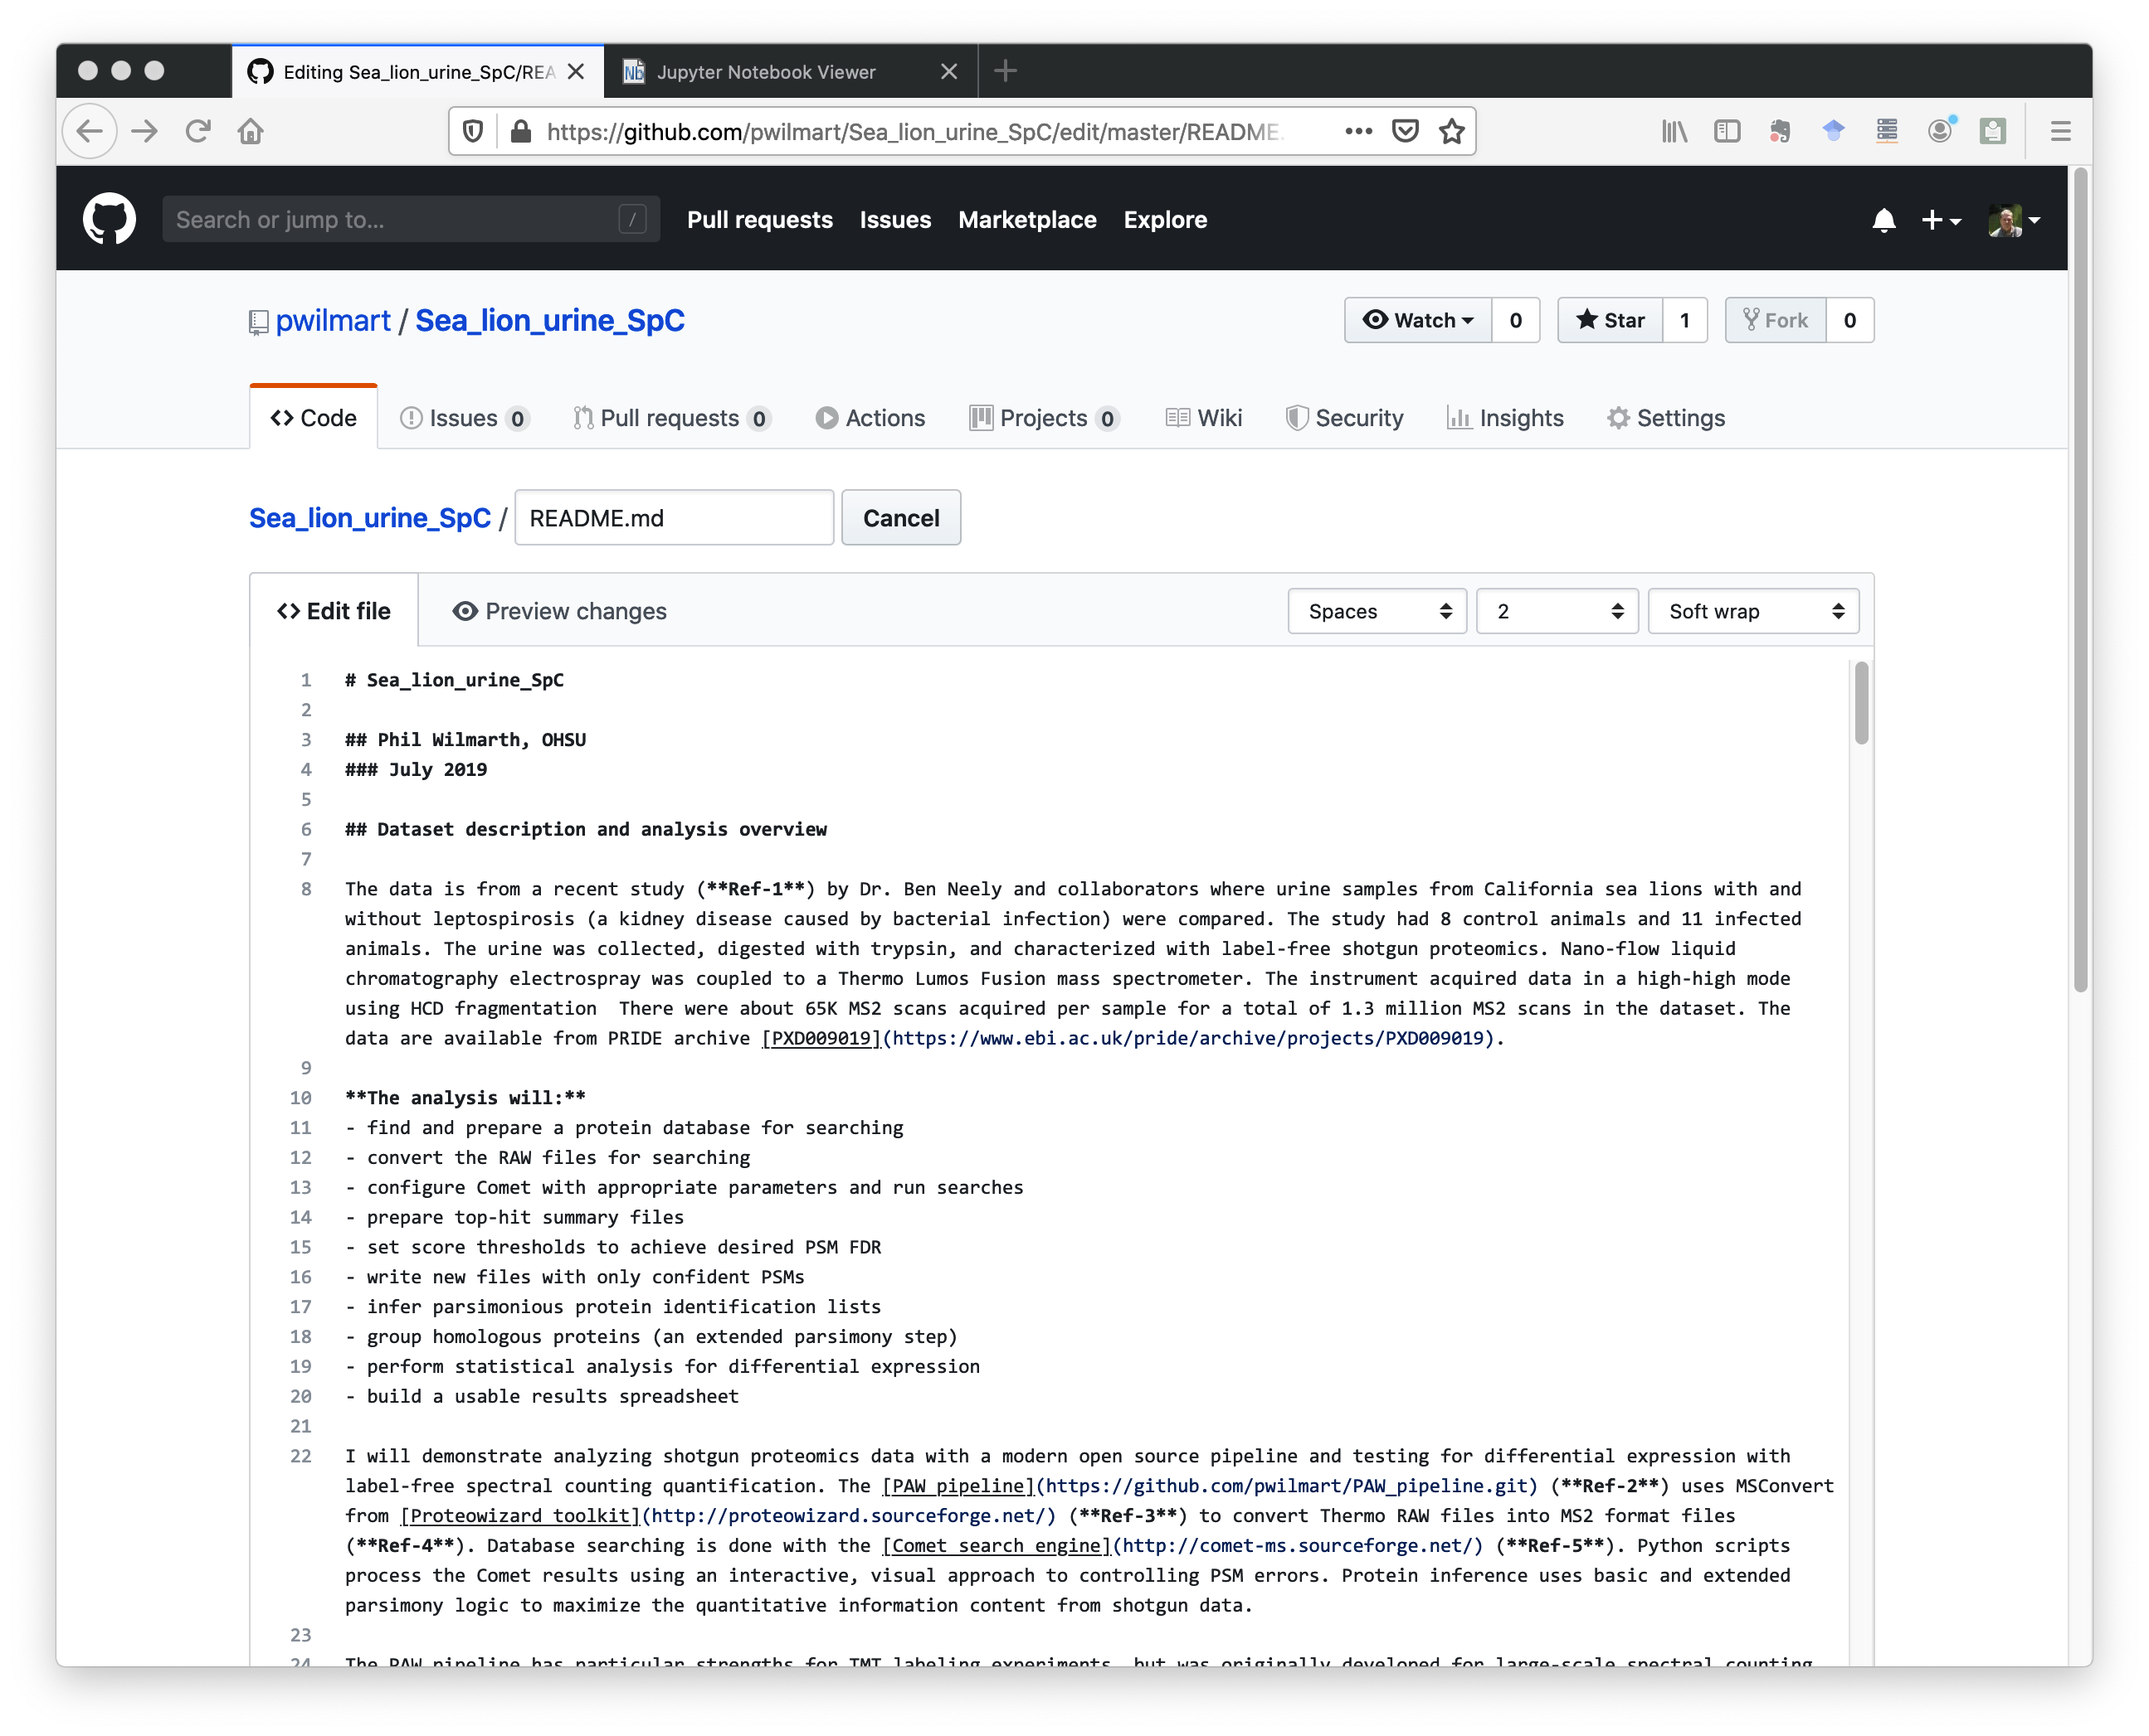
Github markdown more concise than HTML source code
Supports:
Headers
Bold/italic formatting
Hyperlinks
Images
Lists
Tables
Formulas
Etc.
Notes:
This is what the contents of the README.md file looks like. Markdown is more concise and readable than HTML source code. It is a little faster and easier to create web content with markdown. Markdown supports many basic web site features: headers, formatted text, hyperlinks, images, list, tables, etc.

Slide 16
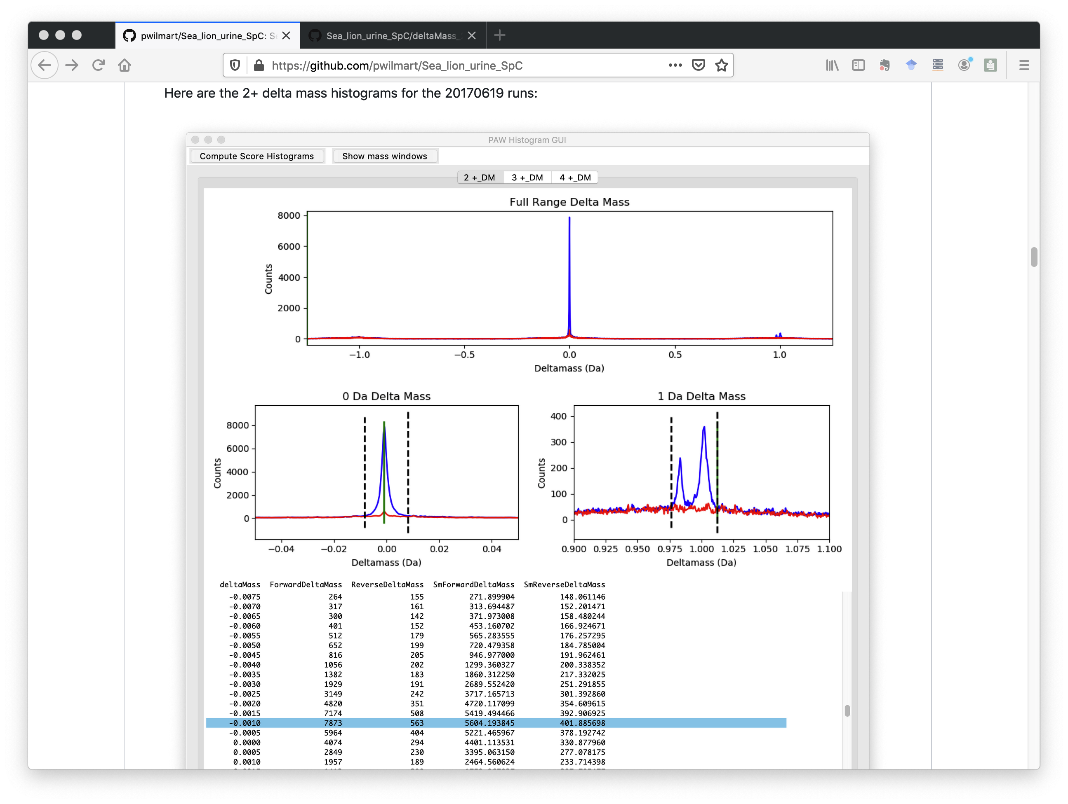
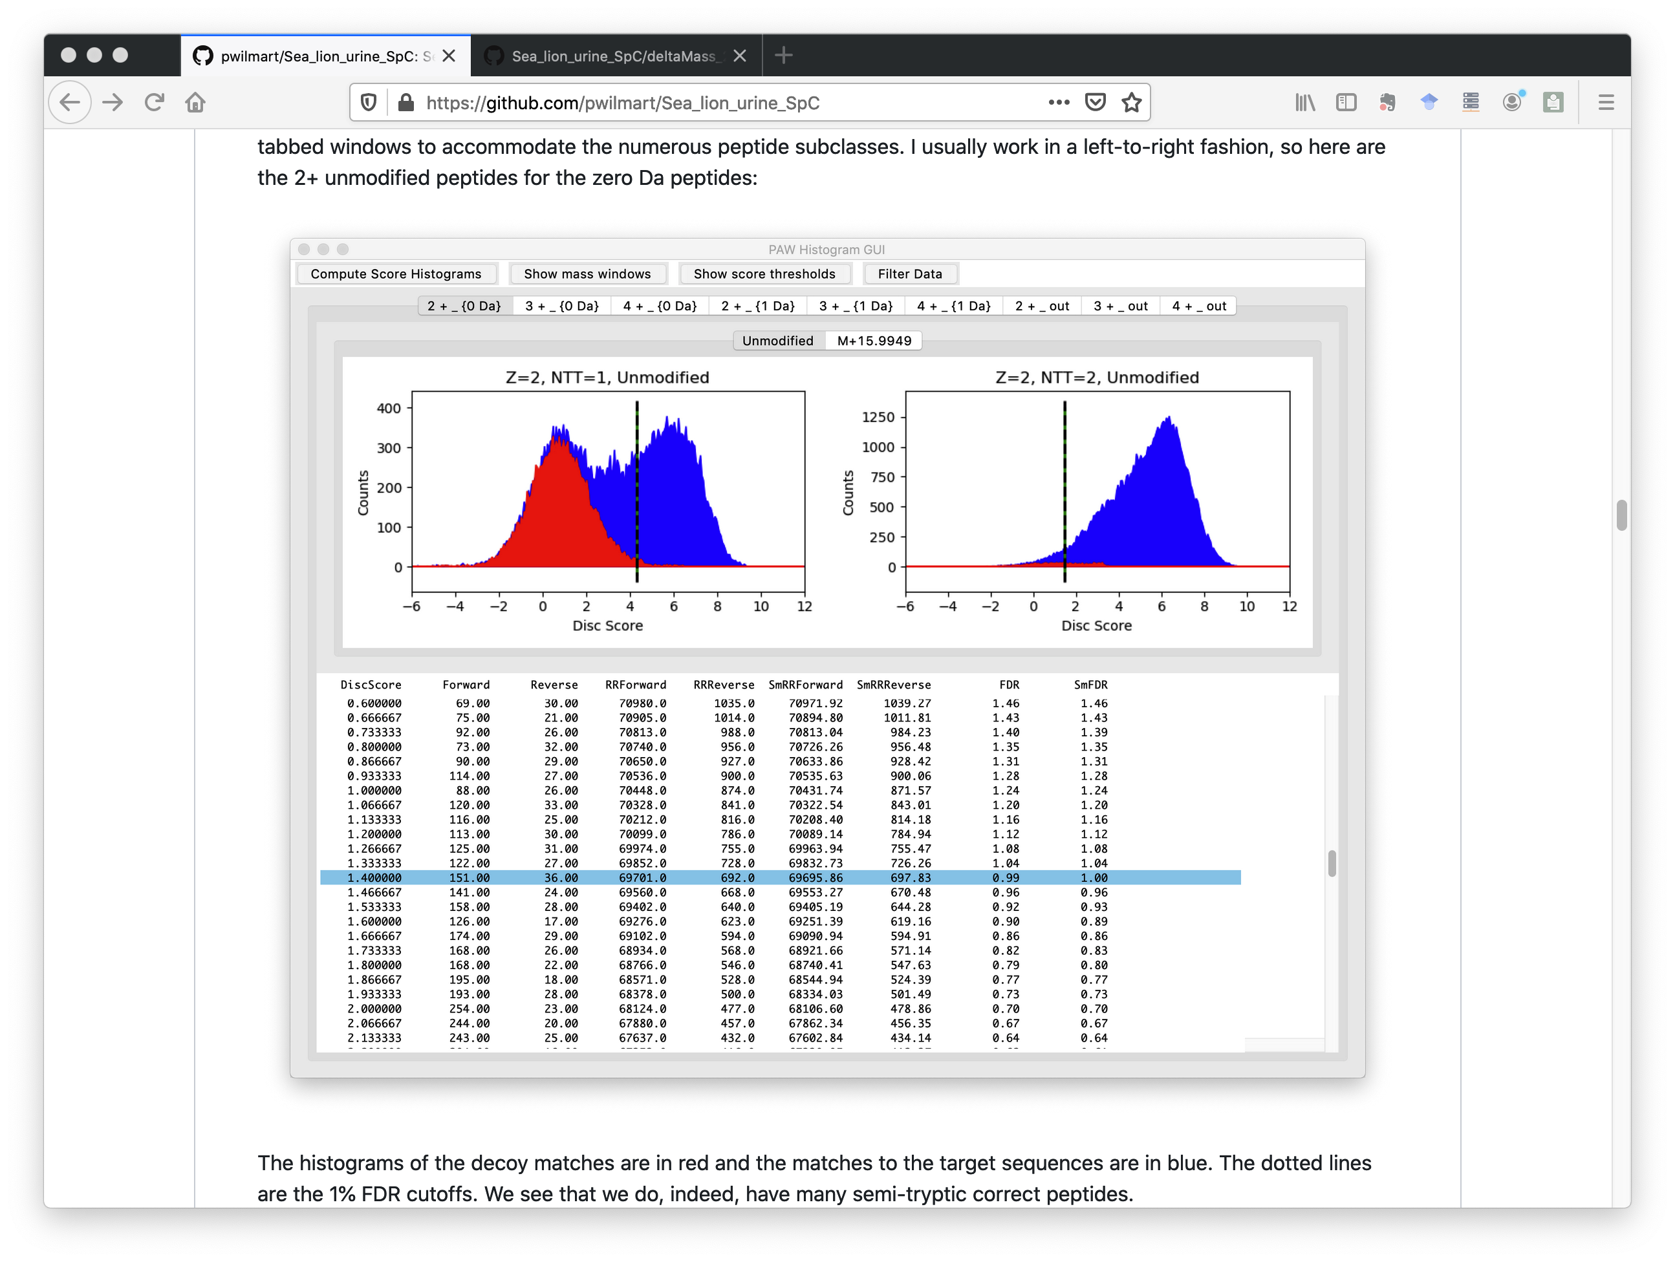
PAW pipeline uses delta-mass conditional score histograms to control FDR
Decoys
Targets
Delta-mass regions
Conditioned score distributions
Notes:
The README file covers the sea lion analysis steps with my pipeline. It uses the target/decoy method in an interactive and visual way to control PSM FDR. High resolution, accurate mass data is not searched by specifying a narrow parent ion tolerance. Instead, a wider tolerance search is done, and delta masses of the matches are displayed (on the left for 2+ peptides). We set windows on the delta mass peaks and then generate the corresponding conditional score distributions. On the right, we have the score distributions for the 2+ peptides in the zero Da window. The decoy scores are in red and the target scores are in blue. The left histograms are semi-tryptic peptides and the right are fully tryptic peptides. The dotted lines are 1% FDR cutoffs.

Slide 17
Dataset and pipeline statistics
There were 1.26 million MS2 spectra from 19 samples
249K PSMs (1% FDR) with PAW/Comet and sea lion database
81% fully tryptic and 19% semi-tryptic
85% unmodified and 15% had oxidized Met
142K PSMs with related species database (walrus and seal)
75% more IDs with seal lion database
Notes:
The README has many more histograms, lots of descriptions, and summary statistics. There were 19 samples with a total of 1.26 million MS2 spectra. About 250 thousand PSMs passed the 1% FDR thresholds. There were 81% fully tryptic versus 19% semi-tryptic peptides. All biofluids (serum, saliva, CSF, and urine) will have a lot of semi-tryptic peptides. The semi-tryptic peptides were a little more abundant than oxidation. I made a similar walrus and seal database like what was used in the publication and did an analysis using that database. The number of identified PSMs dropped to 142 thousand. Using a sea lion database increased the identifications by 75%.

Slide 18
Two sea lion groups: uninfected control and leptospirosis infected kidney
Compare spectral counts between groups
Quality control check of samples
Define what is quantifiable versus identifiable
Apply statistical testing and visualize results
Notes:
The study had 8 sea lions without any kidney disease and 11 sea lions with kidney disease from leptospirosis infection. The paper used label free spectral counting to compare the two groups. Any quantitative study should check the data before doing the statistical analysis. How did the data from each sample turn out? Do they all look okay or are some of them possible outliers to be excluded? We can always identify more things than we can quantify. The bar is higher for quantification. How do we determine a cutoff for quantification? After checking the data, we can do the statistical testing and visualize the results. We can do all of this with notebooks.

Slide 19
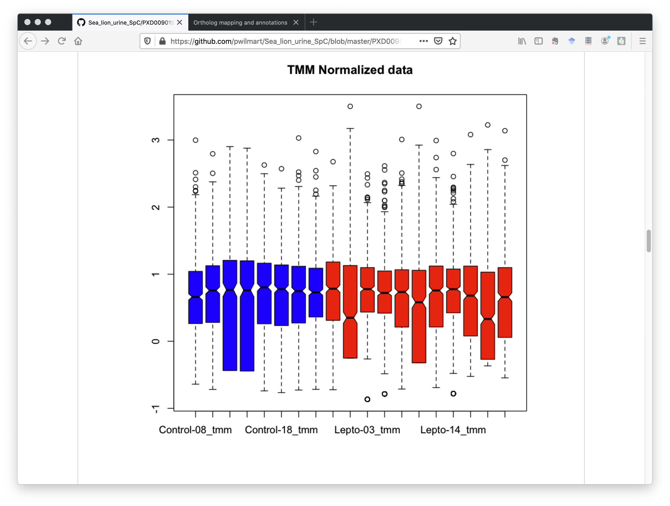
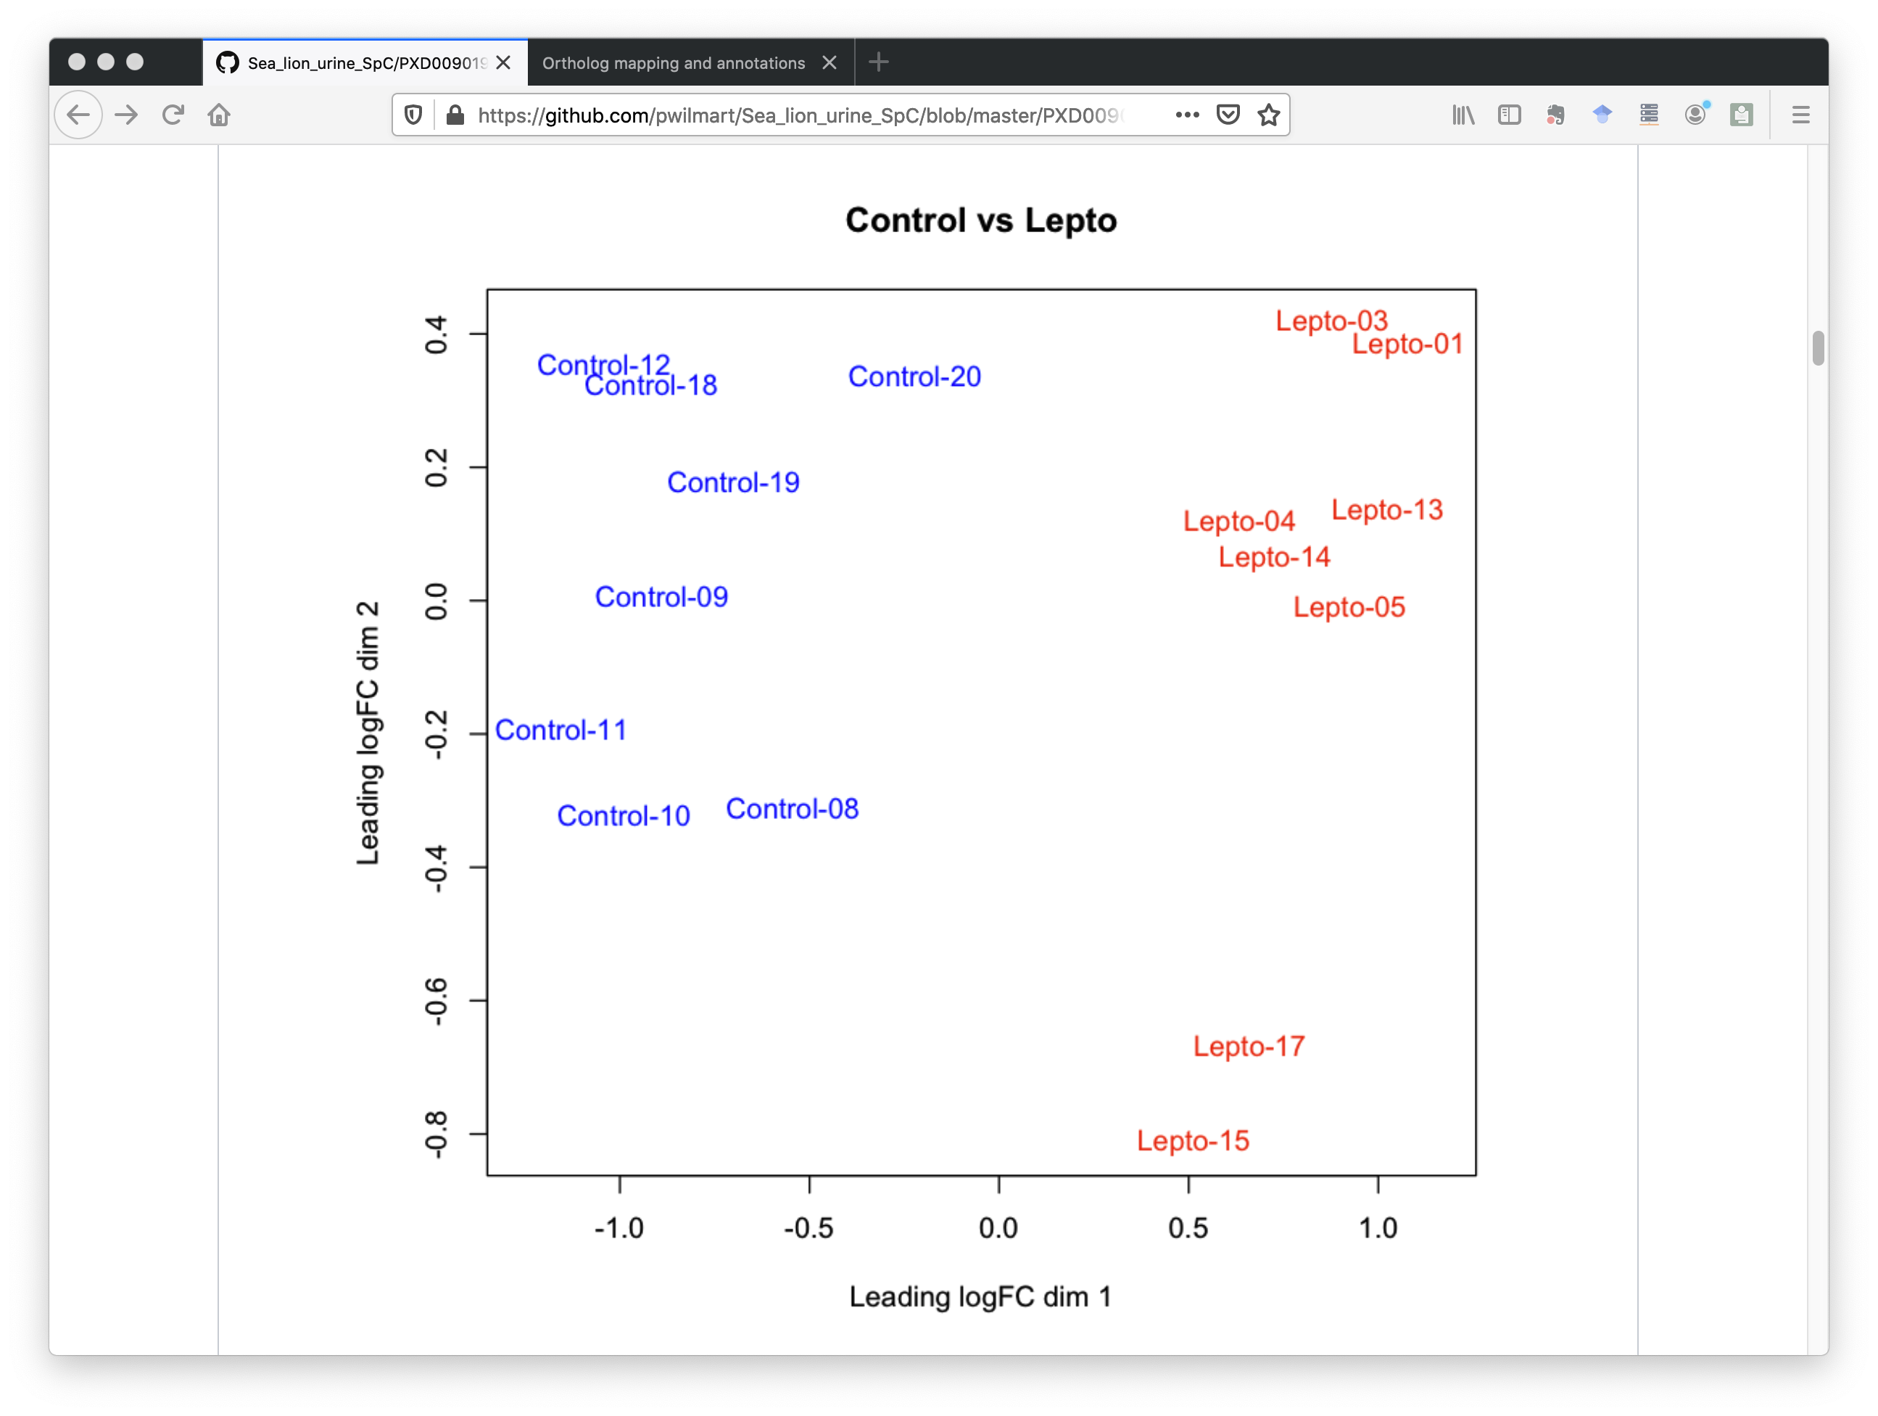
QC notebook: PXD009019_QC_check.ipynb
Low medians
Outliers
Clustering by group
Notes:
The repo has a separate Jupyter R notebook to do some basic quality control processing. The control samples are in blue. The infected samples are in red. The boxplots of the spectral count distributions have 3 infected samples with low count distributions. If we drop those, we still have an 8 by 8 comparison. We can also do some clustering analysis. The plot on the right is a multi-dimensional scaling plot. The two groups are well separated. There are many other R clustering package options that could also be used.

Slide 20
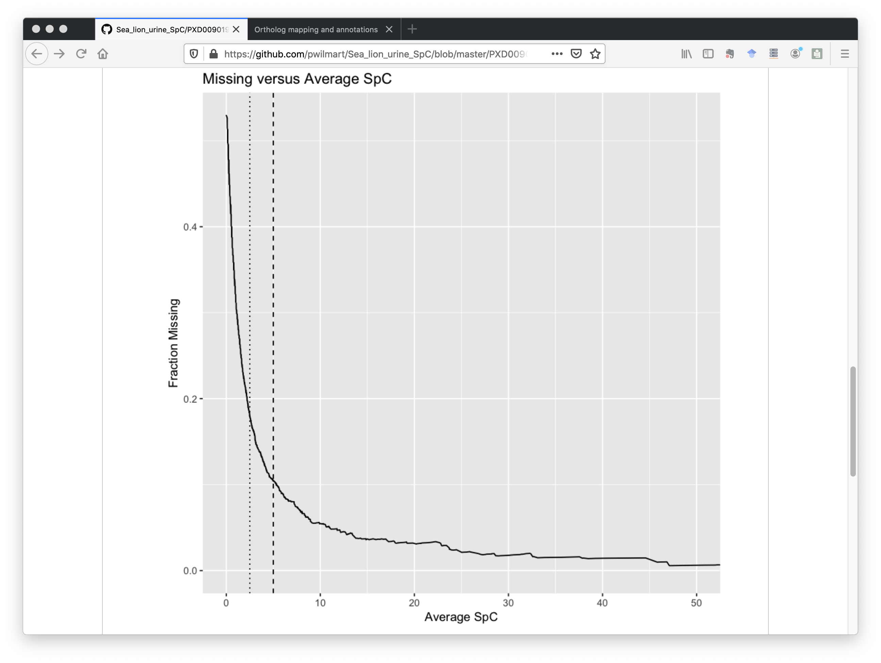
Are all proteins quantifiable?
PXD009019_average_missing.ipynb:
2,262 protein identifications
414 proteins with Ave SpC above 5
82% of total counts
669 proteins with Ave SpC above 2.5
Only 30% of proteins
But 89% of total counts
Ave SpC = 2.5
Ave SpC = 5
Notes:
Each biological sample was analyzed in a single LC run. We had close to 2,300 identified proteins. How many of those can we quantify? If we compute the average spectral count per protein for the samples, we can sort our count table by decreasing average counts. We can count the cells with missing data in the table as a function of protein, from the highest abundance to the lowest abundance (the average SpC) and count all the cells. We can plot the average SpC on the x-axis and the fraction of missing data on the y-axis using another notebook. When we get to small average SpC, we see a sharp rise in missing data. The dotted line is an average SpC of 2.5. That has 669 quantifiable proteins. While this is only 30% of the identified proteins, those 669 proteins account for almost 90% of the total spectral counts observed in the experiment. Using such a cutoff eliminates most of the missing data and its complications.

Slide 21
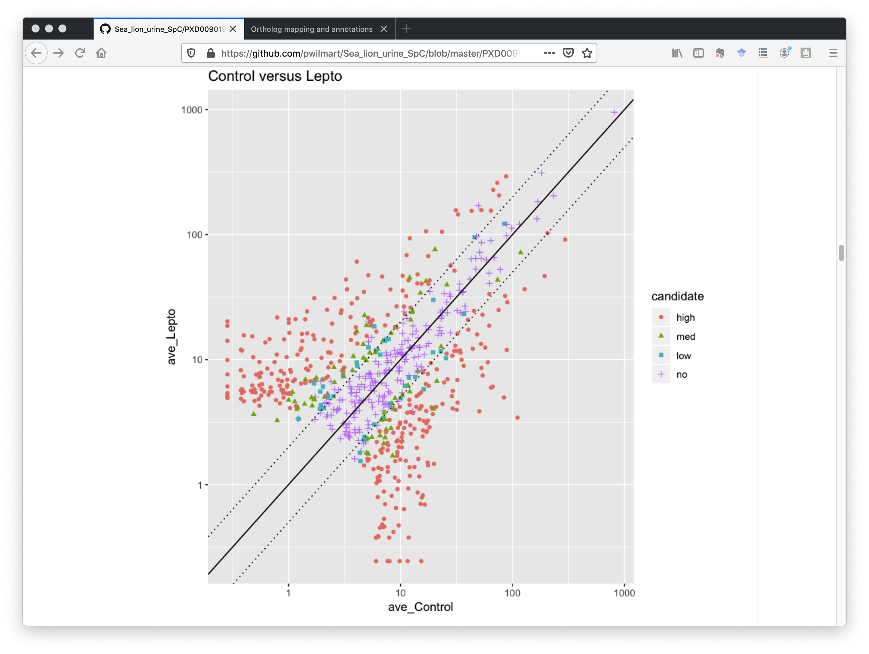
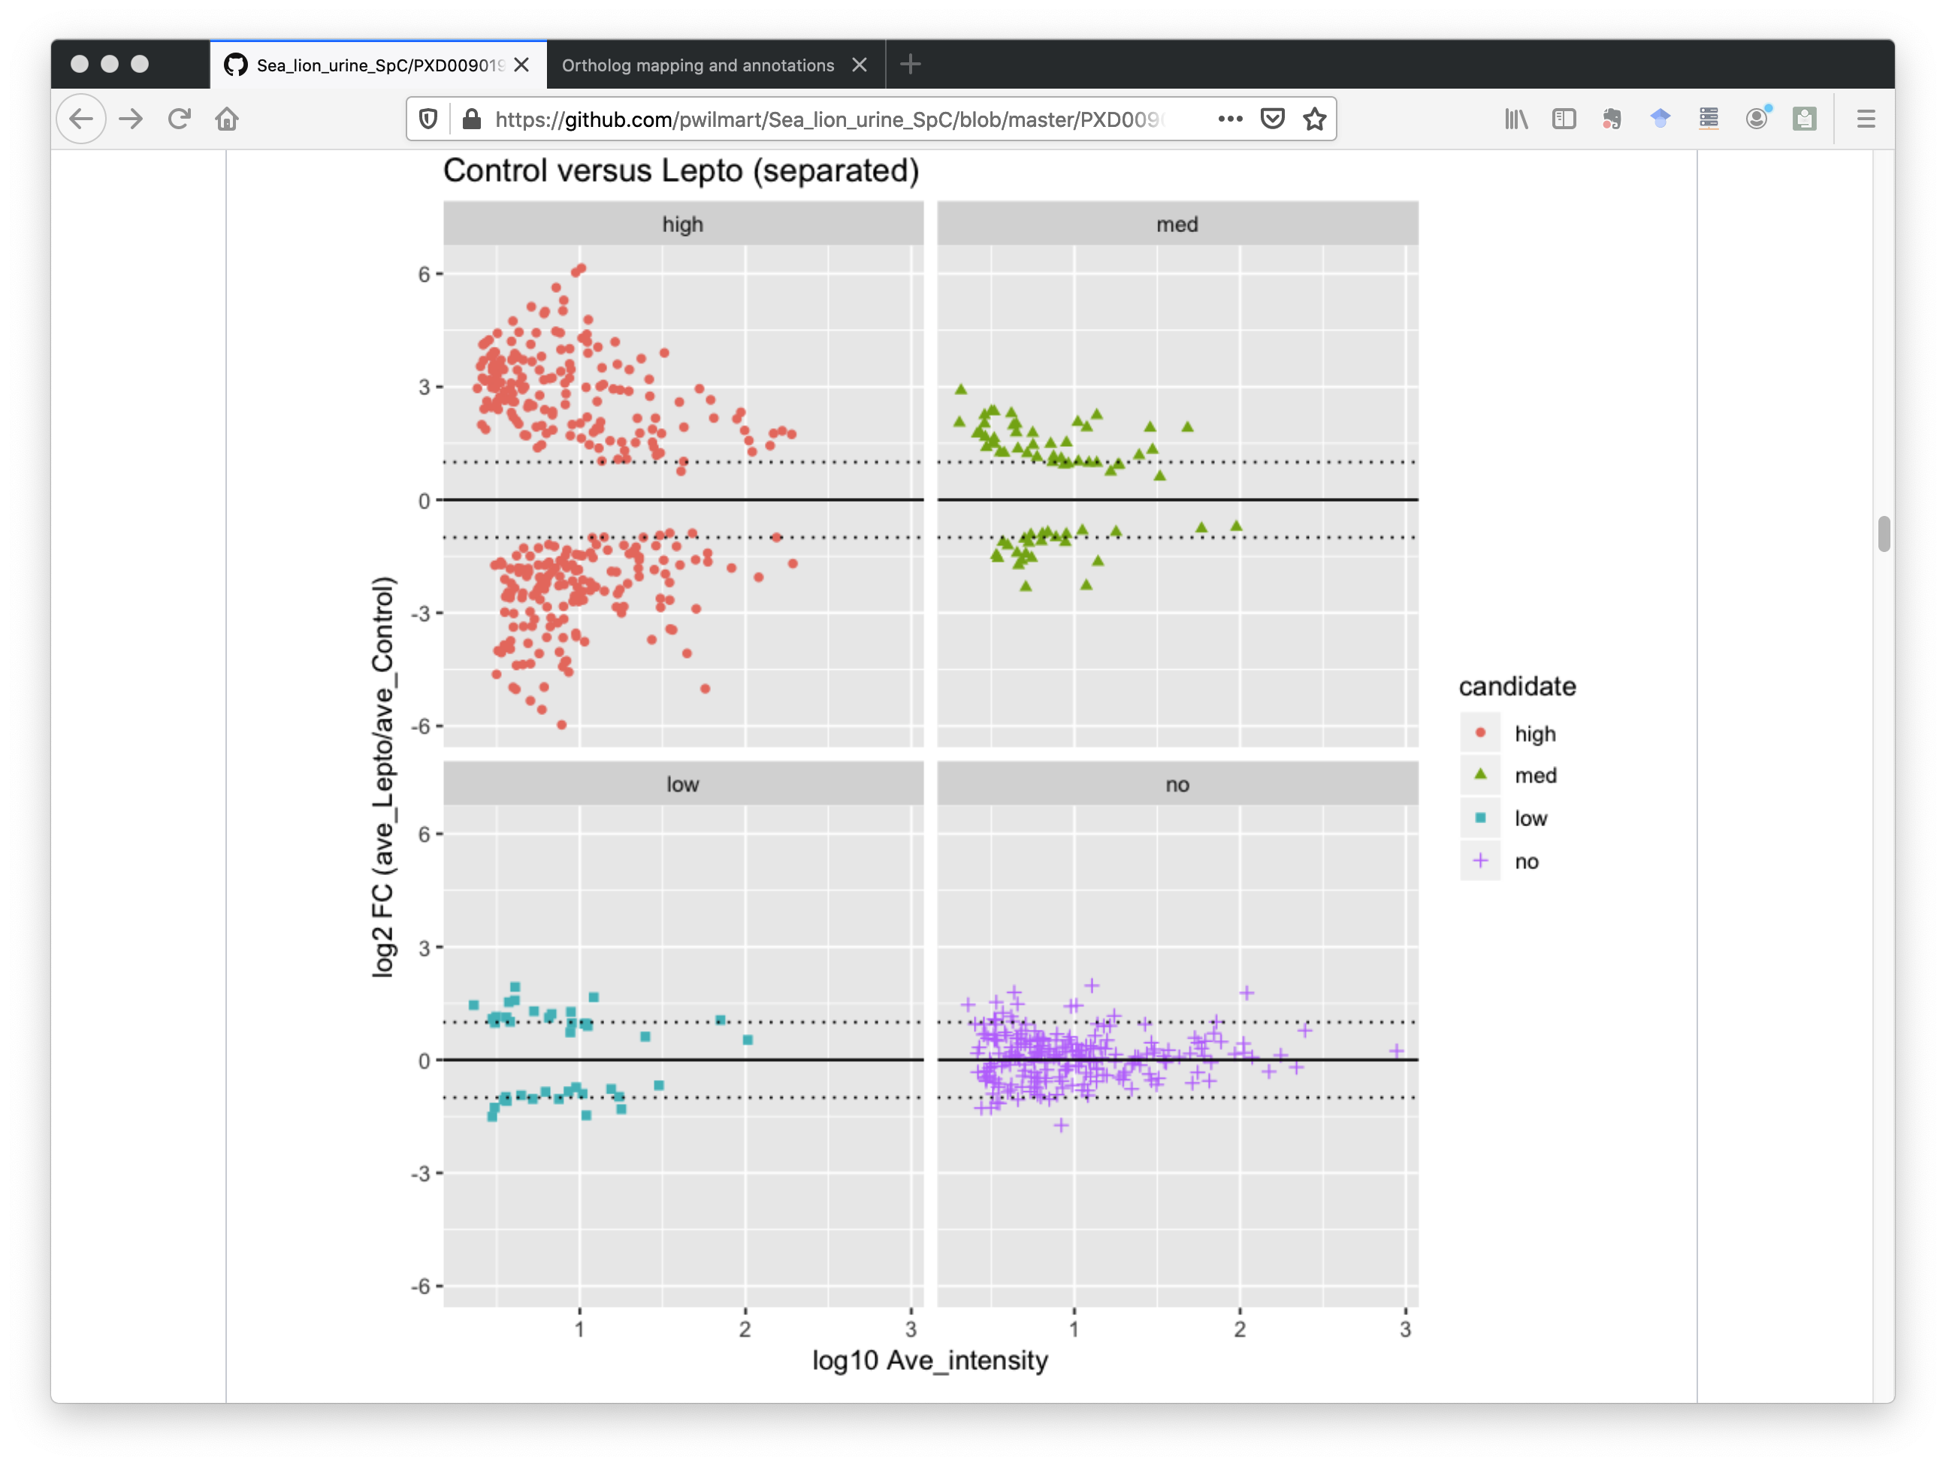
Differential expression testing with edgeR (PXD009019_SpC_DE.ipynb)
0.01 > FDR
0.05 > FDR > 0.01
0.10 > FDR > 0.05
FDR > 0.10
Scatter plots
Faceted MA plots
Notes:
We used the Bioconductor package edgeR to do the statistical testing in an R notebook. Here are just a couple of the many visualizations. We have a scatter plot on the left with differential candidates colored by some significance cuts. We are using Benjamini-Hochberg corrected p-values for significance. We can also make MA plots (commonly used in genomics) where we have separated the DE candidates. The unchanged proteins in purple have mostly less than 2-fold changes. The orange proteins with FDR less than 0.01 have much larger than 2-fold changes.

Slide 22
What’s next?
We identified 2300 of sea lion urine proteins
We found 410 differentially expressed proteins
Publication had 316 DE candidates
Human, mouse are the only annotated higher eukaryotes
Non-model organisms can have poorly annotated genomes
Varies by species and by database source
Map sea lion proteins to better-annotated human orthologs
Notes:
The sea lion database made a big improvement. We identified close to 2,300 urine proteins. We had 400 differential expression candidates. What do we do with the results? We only really have usable annotations for human and mouse among higher eukaryotes. The degree of annotations for other species will be variable. We need to map the sea lion proteins to human orthologs and annotate the sea lion proteins with the corresponding human ortholog annotations.

Slide 23
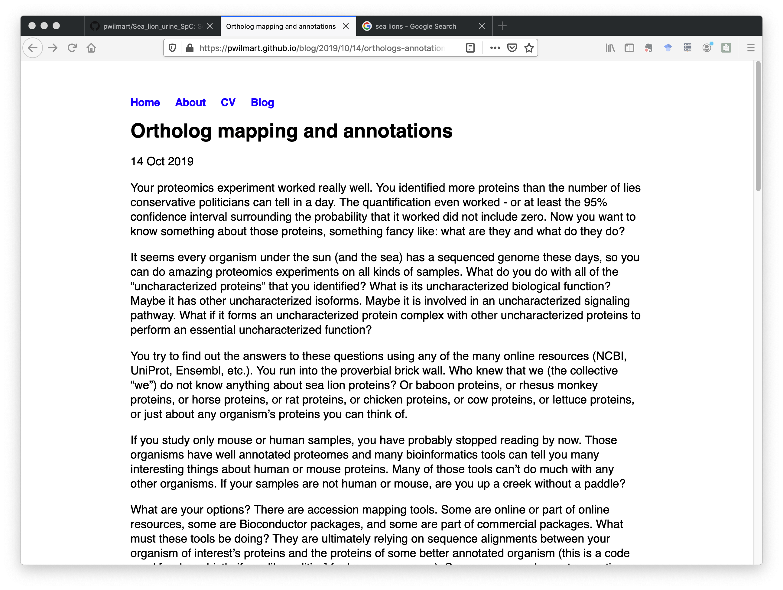
How do we map to human orthologs?
Want one-gene-one-protein sequence lists
Local BLAST program can do many-to-many comparisons
Orthologs defined as reciprocal best matches between species
Use annotations for human
Script this in Python
Notes:
Mapping protein lists from less common species to human or mouse is something I end up doing all the time. It is a little complicated and was perfect for a blog post. We are basically going to use a locally installed BLAST program to align all sea lion sequences against the human Swiss-Prot database and find the best matches. We will map the human annotation information (genes, keywords, GO terms, and pathways) to the sea lion proteins. There are a lot of steps, so it is safer to let the computer do the work.

Slide 24
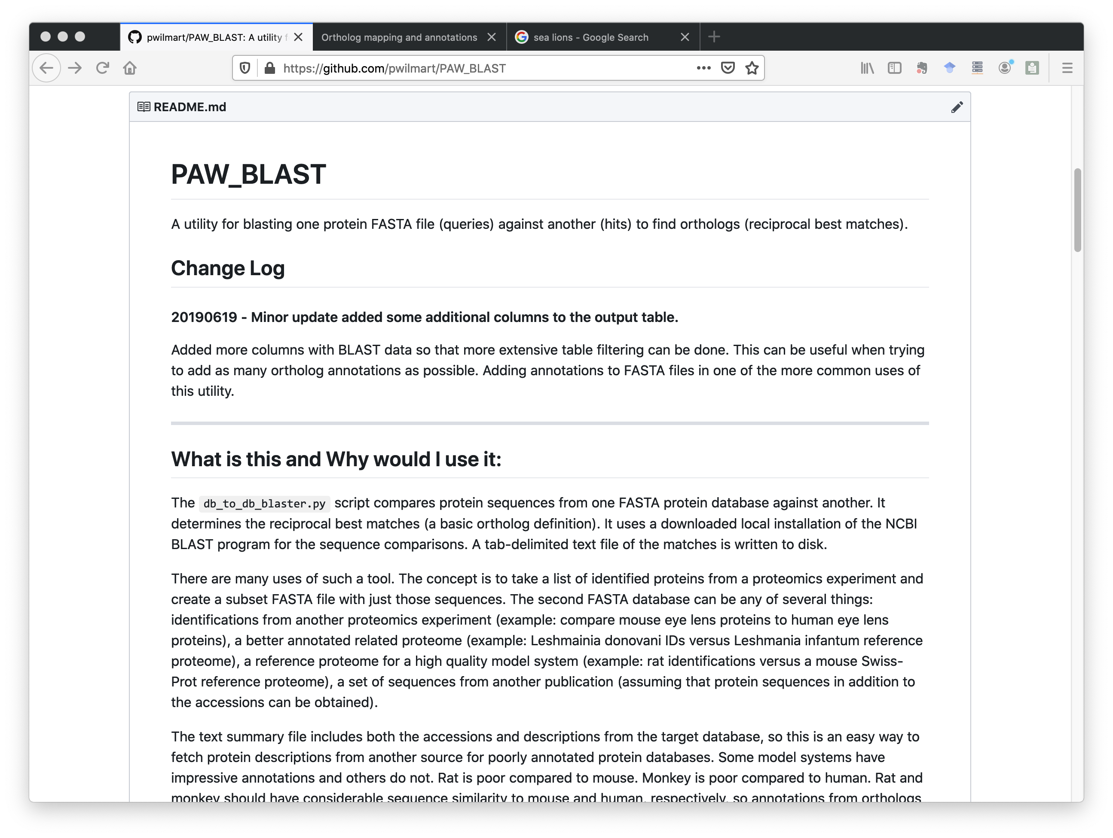
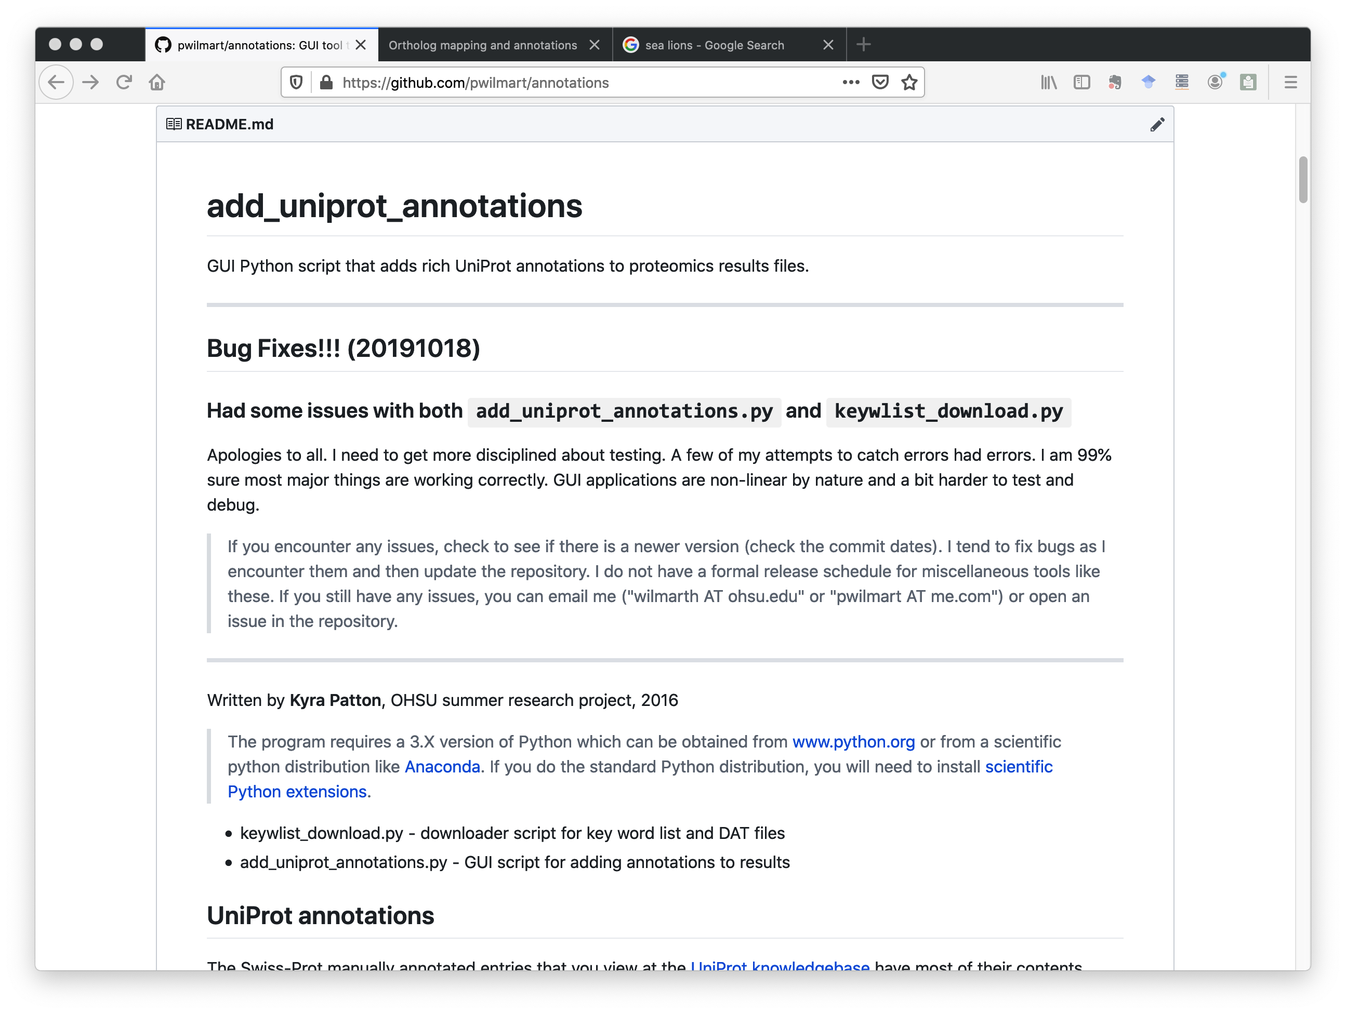
BLAST and Swiss-Prot annotation scripts
github.com/pwilmart/PAW_BLAST
github.com/pwilmart/annotations
Notes:
I have two repositories with scripts for doing this. One does the BLAST run and makes a summary table. The other gets the human annotation information and maps it to the sea lion orthologs. We start with a proteomics results table from my pipeline and add statistical testing results to the table. Then we add ortholog and annotation columns to the table. At the end, we have a more informative report to send to clients and publish.

Slide 25
Github is a powerful communication tool
Demonstrate your analysis expertise
Data analysis examples with notebooks
Distribute your software tools
R and Python scripts
Free web hosting
Web sites, blogs, tutorials, README files
Github URLs are easy to share
Notes:
Github is a powerful communication resource we can use. We saw how to use a repository to illustrate data analysis concepts on public data. We used Jupyter notebooks to help tell our story. We needed some custom scripts in the analysis that we have available at Github. The site webpage and blog were used in the story telling, as well as Github markdown in the README files. All of this is easy to share with the proteomics community thanks to stable Github URLs.

Slide 26
Thank You!
wilmarth@ohsu.edu
pwilmart@me.com
@pwilmarth on Twitter
Notes:
Thank you for your time and I will take any questions.

